Slide 1
A Parallel Algorithm for Construction of Uniform Grids
Javor Kalojanov, Philipp Slusallek
Saarland University
Notes:
Good morning, my name is Javor, and I am going to talk briefly about constructing uniform grids for ray tracing on graphics hardware.

Slide 2
Motivation
Grids for GPU ray tracing
Trade off quality for fast construction
Parallel construction
Computational power of GPUs
Memory bandwidth of GPUs
Existing algorithms not “massively parallel”
Atomic synchronization
Work distribution not scene independent
Notes:
We were interested in evaluating the tradeoff between build time and rendering performance provided by uniform girds.
There has been research for ray tracing with grids and grid construction on CPUs, but we were not aware of how things look like on a graphics card.
While no one expects good acceleration for ray tracing from uniform grids, they should be very fast to construct, especially on a highly parallel architecture, that has the computational power and bandwidth of modern GPUs.
Unfortunately previous parallel construction algorithms either rely on atomic synchronization to resolve write conflicts, or cannot guarantee good work distribution. These problems do not influence performance as much on a multi-core CPU system, but one needs very high parallelism in order to exploit the resources of a graphics card.
So we tried to figure out a “massively parallel” grid construction algorithm.

Slide 3
Data Structure
1
2
Array of primitive references
Cells are ranges in the array
0
1
2
3
4
5
1
2
1
1
2
[0,2)
[2,3)
[3,4)
[4,5)
[0,0)
[0,0)
[0,0)
[0,0)
[0,0)
Notes:
The data structure we are interested in constructing, consists of two parts.
First we have an array of primitive references. Each primitive is pointed to as many times as the number of cells this primitive overlaps. Furthermore references to the primitives contained in the same cell are stored next to each other in the array.
The grid cells then are just ranges in the cell array. For example the upper left cell contains triangle 1 and 2, and it’s range in the array contains references to these triangles.
The standard approach to grid construction is to go through the input primitives and to insert them in all cells that they overlap. This is not so easy to do on a GPU, because you allocate memory dynamically. It also requires atomic synchronization if insertions in the same cell can be performed by multiple threads.
So we take a different approach.

Slide 4
Algorithm Overview
1
2
Reduce to sorting
Write pairs of references and cell indices
Sort
Extract cell ranges
1
0
1
1
1
2
1
0
2
3
2
2
0
1
0
2
1
1
2
1
3
2
3
[0,2)
[2,3)
[3,4)
[4,5)
[0,0)
[0,0)
[0,0)
[0,0)
[0,0)
Notes:
Instead of inserting primitive references in the final structure, we just output a pair of cell index and primitive index for each cell overlapped by each primitive.
We store those pairs in an array, which we sort using the one-dimensional cell index as key. After we sort the array all primitives contained in the same cell are next to each other, and we can compute the range of each individual grid cell.
In this way we avoid the need of atomic synchronization, since each thread outputs into its own part of the array.
You will also see that in each step of the algorithm, all threads are kept busy, so there are no problems caused by work distribution.

Slide 5
Implementation
Main idea already implemented
CUDA SDK, particle demo
Here
Each Primitive overlaps any number of cells
Unknown number of references
Write conflicts
Solution
Count references
Segment output array
Notes:
Here is the place to say, that the idea of reducing the construction to sorting has been implemented in the particle demo in the CUDA SDK. However there the primitives over which the grid is constructed are points, which greatly simplifies the algorithm.
If we build the grid over other geometric primitives, like triangles, several issues arise from the fact that primitives can overlap any number of cells.
First of all we don’t know in advance the total number of references that we want to store. This gives us the size of the output array. We need to pre-allocate it, since dynamic memory allocation is not possible on GPUs.
Also when writing the cell-primitive pairs, each thread will write different number of elements. We want to segment the output array in order to guarantee conflict-free writes.
In order to resolve this issues we run two additional functions before we the begin of the algorithm. Together they compute both the total number of output elements, and a segmentation of the output array.
After that we allocate the needed memory and proceed with the algorithm.

Slide 6
Count Primitive References
Thread Block 1
Thread Block
Shared Memory
2
1
3
2
2
3
Thread Block 3
Shared Memory
3
2
4
1
2
3
Thread Block 4
Shared Memory
1
3
1
4
2
1
Shared Memory
4
1
2
4
3
2
Reduce
Global Memory
13
15
12
16
Exclusive Scan
0
13
26
38
54
Notes:
I hope that most of you have a basic understanding of the CUDA programming model. What you need to know is that a CUDA kernel is executed in parallel by multiple threads, grouped in blocks. Threads inside the same block share a fast on-chip memory. To communicate results between blocks, one has to use the much slower global memory.
To compute the size of the output array, we load primitives in parallel and count how many cells are overlapped by each.
Each thread can consecutively processes multiple primitives, and accumulates a single counter in shared memory. After all primitives are processed CLICK, the output size of the whole blocks are computed via reduction and stored in global memory.
Then we perform a scan over the temporary result. CLICK We only have as few elements as thread blocks, so this is very fast.
The scan gives us the total size of the output array plus a segmentation of it between thread blocks.

Slide 7
Write Unsorted Pairs
Next primitive:
Scan result:
0
13
26
38
54
19
Thread Block 4
38
Next Free Slot:
42
Output Array:
38
42
3
19
13
19
14
19
15
19
Notes:
We now know the total size of the output array, so we allocate it and start writing the pairs of cells and primitives.
We use the scan result for segmentation, and because of that we have to map the threads to the same primitives as in the counting step. The between-block segmentation is not the only information required for conflict free writes, since we need to ensure that writes by threads in the same block do not collide.
We use a per-block counter in shared memory that is incremented atomically to reserve space for each thread.
You can see how it works in the example. We first fetch the begin of the output segment for the block. And then for each primitive we compute how many cells does it overlap, reserve the space in the output and write the pairs.
It is also possible to make a scan in shared memory in the same way we did this in global memory for the blocks.
The second approach is write-conflict free, but the first is equally fast and more convenient.

Slide 8
Radix Sort
Fastest GPU sort algorithm
Parallel implementation
Linear work complexity
Fits the data (integer cell indices)
Notes:
As promised, after we write all pairs to memory we sort them.
One can use any sort algorithm for this stage.
We chose radix sort since it is the fastest GPU sort available, it has parallel implementation with linear work and constant depth complexity. Additionally a fast implementation is available in the CUDA SDK.
It is an integer sort and our cell indices are integers, so the data fits the algorithm as well.
When implementing the algorithm on a different parallel architecture (e.g. next generation GPUs or Larrabee) one can use another probably faster sort method.

Slide 9
Cell Ranges
Thread Block
Extract from sorted data
Load chunk-wise into shared memory
Find neighboring pairs with different cell indices
Update the corresponding cells
0
1
0
2
1
1
2
1
3
2
[0,2)
[2,3)
[3,4)
[4,5)
[0,0)
[0,0)
[0,0)
[0,0)
[0,0)
Notes:
From the sorted data we can compute the cell ranges, that we use for ray tracing.
We load the sorted array chunk-wise into shared memory. Then we check in parallel if neighboring cells have different cell indices. This indicates the begin and end of a range. The corresponding thread updates the grid cells.
The good thing about this approach is that one must make one write per non-empty cell in order to initialize all cells. For the scenes we tested usually 90% of the cells were empty, so there is a performance benefit in not accessing all cells with random accesses.
This concludes the build algorithm.

Slide 10
Analysis
Runtime dominated by sorting
Linear work complexity
No write conflicts
Notes:
When looking at the way runtime is distributed between the different stages, you see that the dominant part is the sorting stage. So bottom end is that we trade off full sort for conflict free writes.
We also included an additional overhead of binding the cell data to a 3 dimensional texture, since we use it for rendering. In this way the complete time to setup the data for rendering is measured.
To put this into perspective: We also implemented a build algorithm based on atomic synchronization on global memory. It was 3 to 5 times slower than the sort-based algorithm.

Slide 11
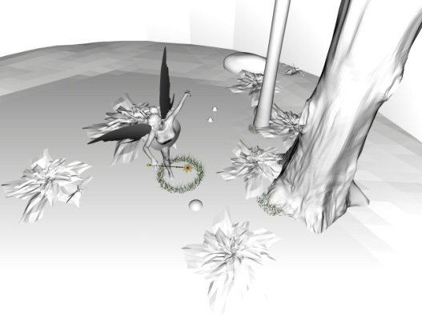
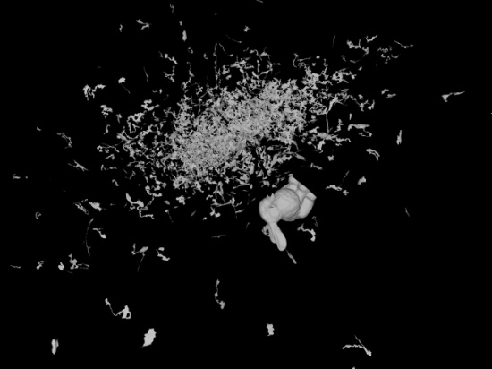
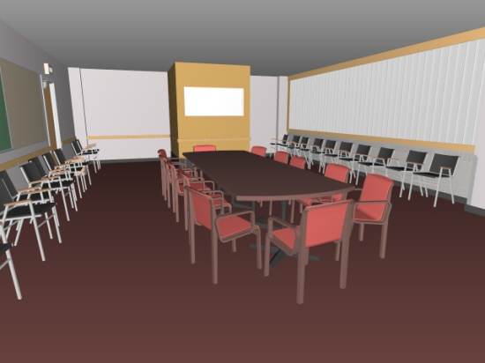
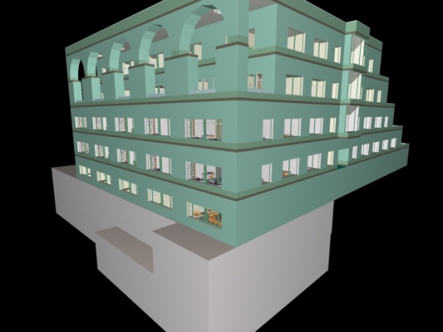
Results
Model (Triangles) | LBVH GTX280 | Grid GTX280 | Hybrid BVH GTX280
Fairy (174K) | 10.3ms 1.8 fps | 24ms 3.5 fps | 124ms 11.6 fps
Bunny/Dragon (252K) | 17ms 7.3 fps | 13ms 7.7 fps | 66ms 7.6 fps
Conference (284K) | 19ms 6.7 fps | 27ms 7.0 fps | 105ms 22.9 fps
Soda Hall (2.2M) | 66ms 3.0 fps | 130ms 6.3 fps | 445ms 20.7 fps
Times for primary rays and simple shading (no shadows). Frame rate does not include build time. 1024² window.
Notes:
Let me report some more results.
This table is more or less copied from the paper, so I will spare you the details. You see build times and frame rate.
We compare our grid construction together with a simple non-optimized ray tracer implementation to 2 alternatives. The purpose of this comparison is to give you some intuition of how good acceleration structure you can get in what time, but frame rate for all three approaches is much faster for optimized ray tracers.
I suppose that relation between the three will remain the same even after optimizations.
The LBVH and Hybrid BVH are both constructed on the GPU and our implementation with grids offers somewhat slower construction times than the LBVH, which is fastest to build, and significantly slower rendering than the Hybrid BVH.
However the build time of the Hybrid BVH is very large and will be a bottleneck in a dynamic application, so it is not automatically better than the other two structures.

Slide 12
Future Work
Apply to other acceleration structures
Two level grids
Top level – uniform grid
Each cell is a grid
Independent resolution
Single sorting pass for level 2
Model (Triangles) | Hybrid BVH GTX280 | Grid GTX280 | 2 level Grid GTX285
Fairy (174K) | 124ms 11.6 fps | 24ms 3.5 fps | 28ms 9.9 fps
Conference (284K) | 105ms 22.9 fps | 27ms 7.0 fps | 89ms 11.8 fps
Notes:
Finally, I would like to tell you about a continuation of our work.
The presented algorithm can be extended to construct two level grids. By two level grid I mean an uniform grid with each cell a grid itself. Every second level cell has individual resolution.
The good thing is that it is possible to construct the complete structure with just 2 sorting passes – one for the top level and one for the second level. The 2 level grid provides better acceleration for ray tracing in scenes with uneven triangle distribution (the teapot in the stadium problem).
This is still work in progress so we included the fairy scene where the 2 level grid works very well and the conference. The second is not a big success since the construction is significantly slower. The problem there is that there are many references to be sorted in the second grid level, but we have several ideas of how to work around this…
I would like to conclude the talk by pointing out that our results suggest, that one can build acceleration structures that have reasonable and even good quality for ray tracing in linear time.

Slide 13
Thank You!

Slide 14
Results (2)
Model (Triangles) | Grid Dual Xeon | LBVH GTX280 | Hybrid BVH GTX280 | Grid GTX280 | Grid GTX285*
Fairy (174K) | 68ms 3.9 fps | 10.3ms 1.8 fps | 124ms 11.6 fps | 24ms 3.5 fps | 22ms 8.5 fps
Bunny/Dragon (252K) | - - | 17ms 7.3 fps | 66ms 7.6 fps | 13ms 7.7 fps | 11ms 8.9 fps
Conference (284K) | 89ms 4.0 fps | 19ms 6.7 fps | 105ms 22.9 fps | 27ms 7.0 fps | 24ms 11.2 fps
Soda Hall (2.2M) | - 8.0 fps | 66ms 3.0 fps | 445ms 20.7 fps | 130ms 6.3 fps | 120ms 7.5 fps
Times for primary rays and simple shading (no shadows). Frame rate does not include build time. 1024² window.
*Implementation running on GTX 285 includes persistent threads.
Notes:
In the first column are the results of Wald’s coherent grid traversal algorithm running on a dual Xeon processor. You see that our build times are significantly faster and even though the hardware used to evaluate their performance is outdated, I think that our implementation can compete with a modern 8 core processor.

