Slide 1
Microtiles: Extracting Building Blocks from Correspondences
Javor Kalojanov, Martin Bokeloh, Michael Wand, Leonidas Guibas, Hans-Peter Seidel, Philipp Slusallek
Notes:
I will present our paper on building blocks from partial symmetries, which we call microtiles.

Slide 2
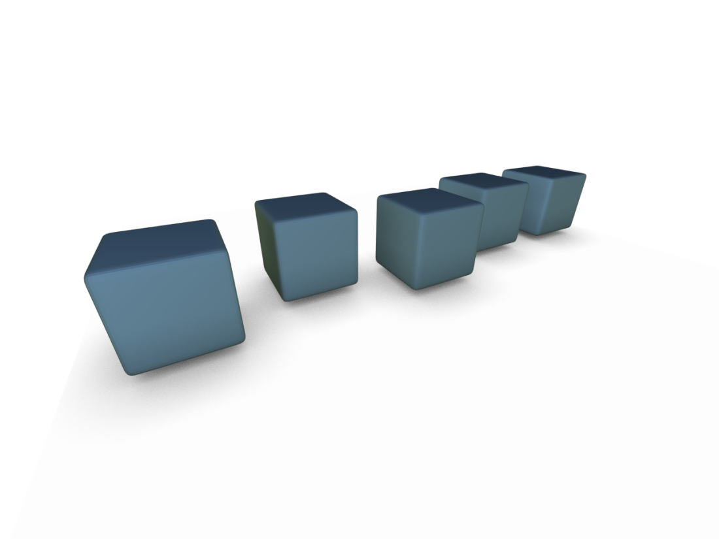
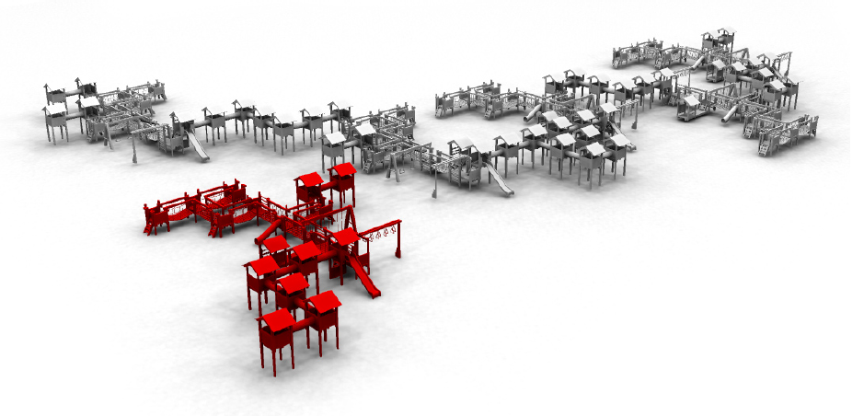
Overview
Partial Symmetries
Inverse Procedural Modeling
Notes:
The talk has 2 parts.
First we introduce a formal model for structuring partial symmetries.
Then we look at how this structure can help us understand inverse procedural modeling.

Slide 3
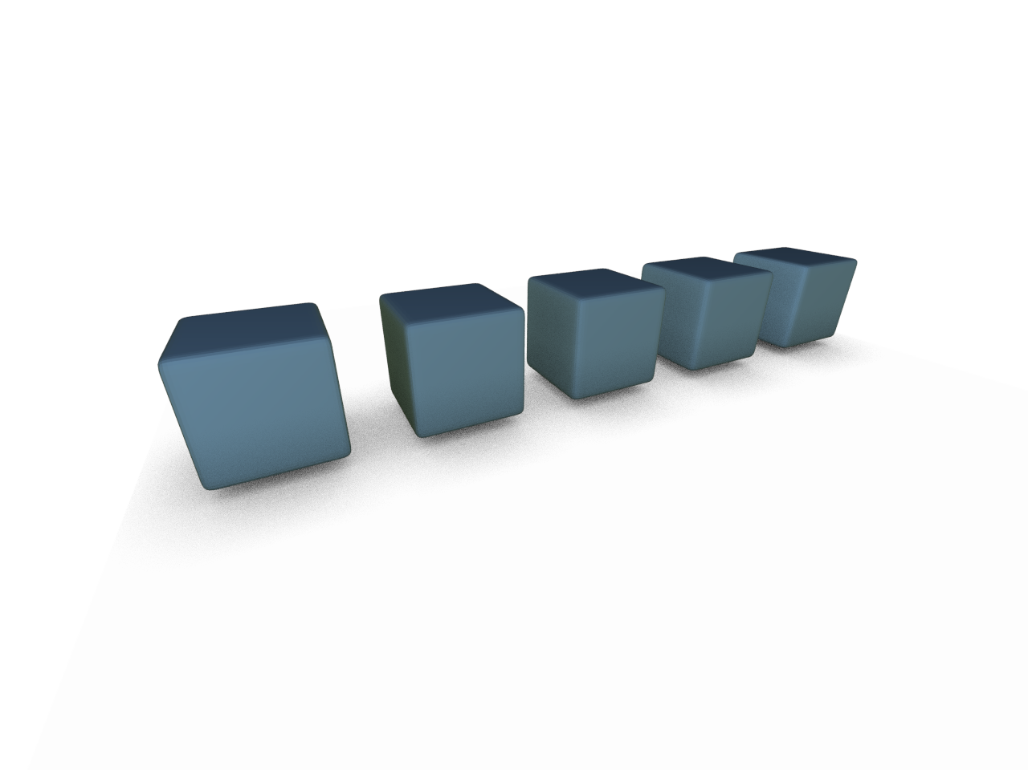
Structuring Partial Symmetries
Part I
Notes:
We want to derive a formal model that describes a structure of a shape based on its partial symmetries.

Slide 4

Goal
Exchangeable building blocks
Notes:
Simply said, given an object like this set of cubes, we are interested in defining elementary pieces or building blocks. These should encode all redundancy information. In the end we will be able to identify a single cube as a microtile, but it is not trivial to arrive to this conclusion, because…

Slide 5
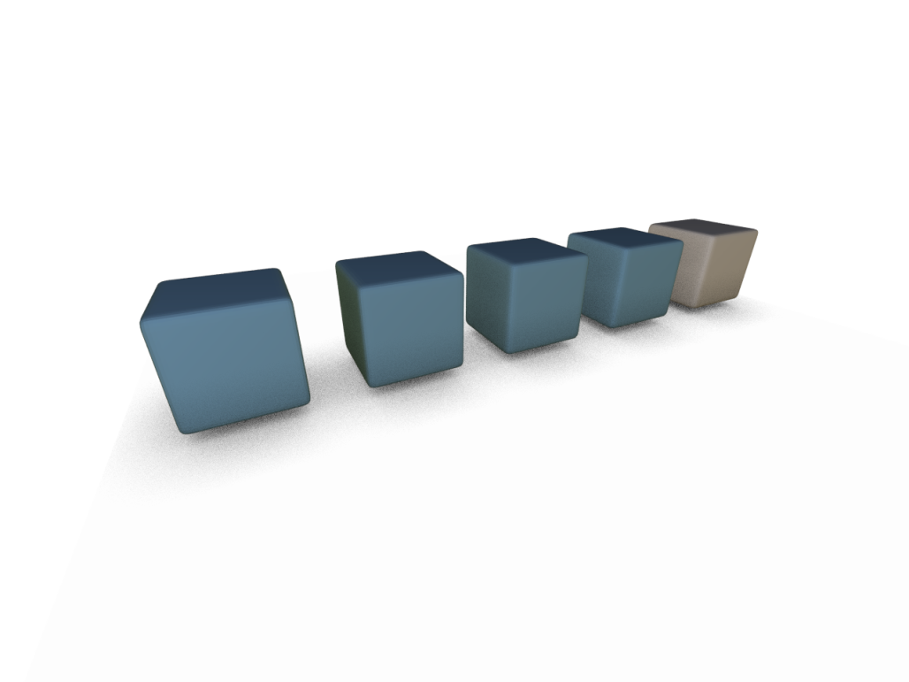
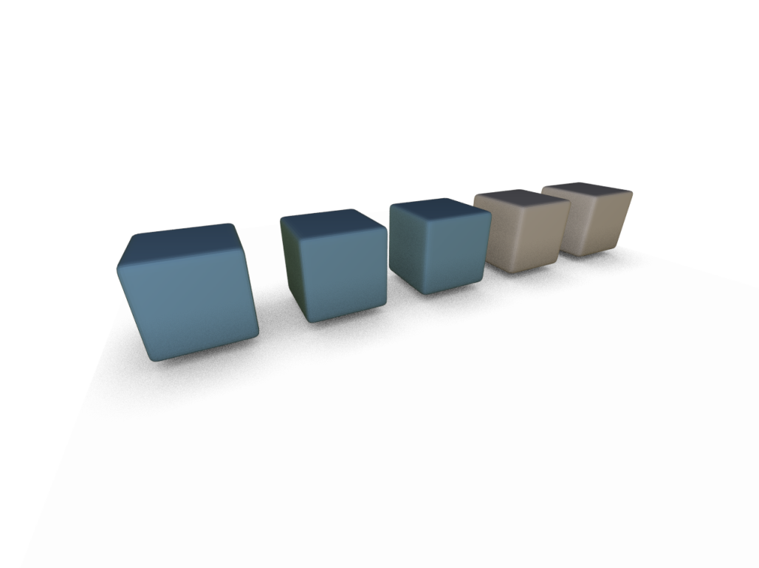
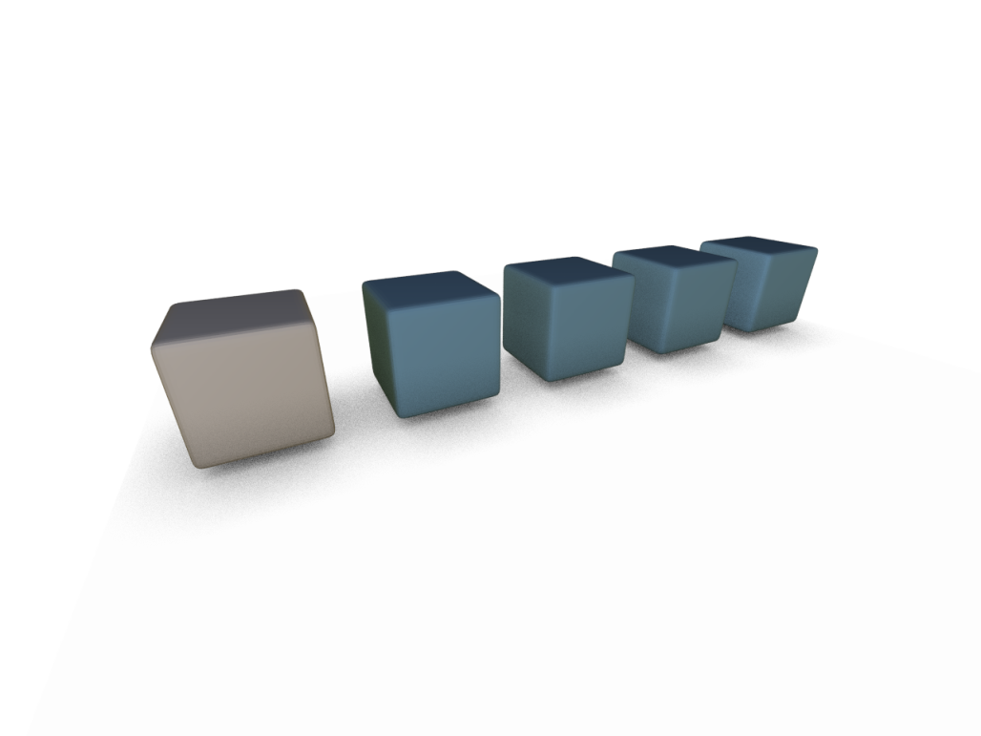
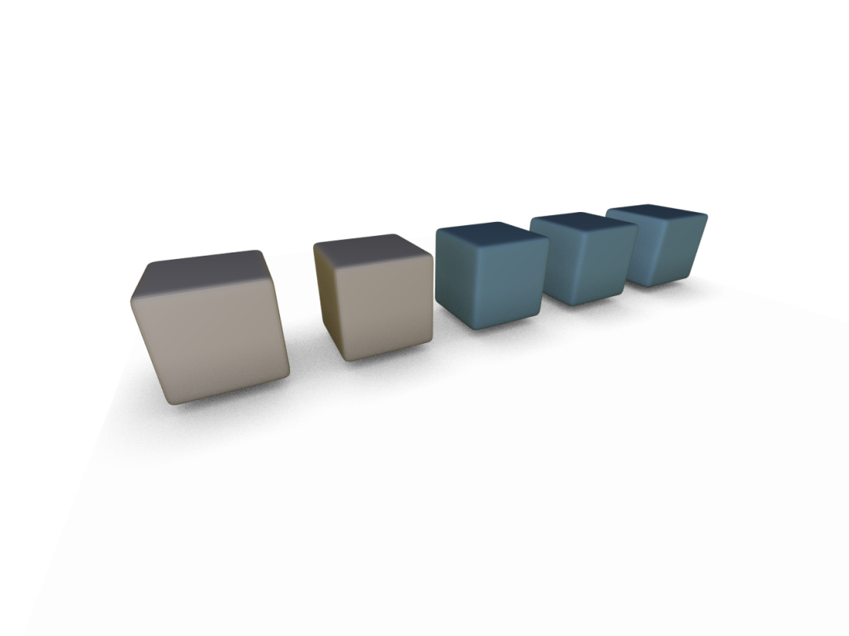


Pairwise matches
$$T_{1}$$
$$T_{2}$$
Notes:
What people can easily do with geometry is to compute pairwise matches. We therefore have to recognize the building blocks by looking at those pairwise matches. As you can see in this two examples the parts of the model identified as corresponding do not easily reveal the desired structure.

Slide 6
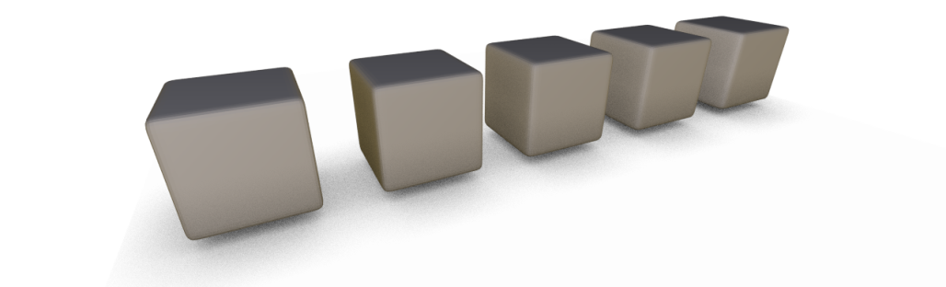
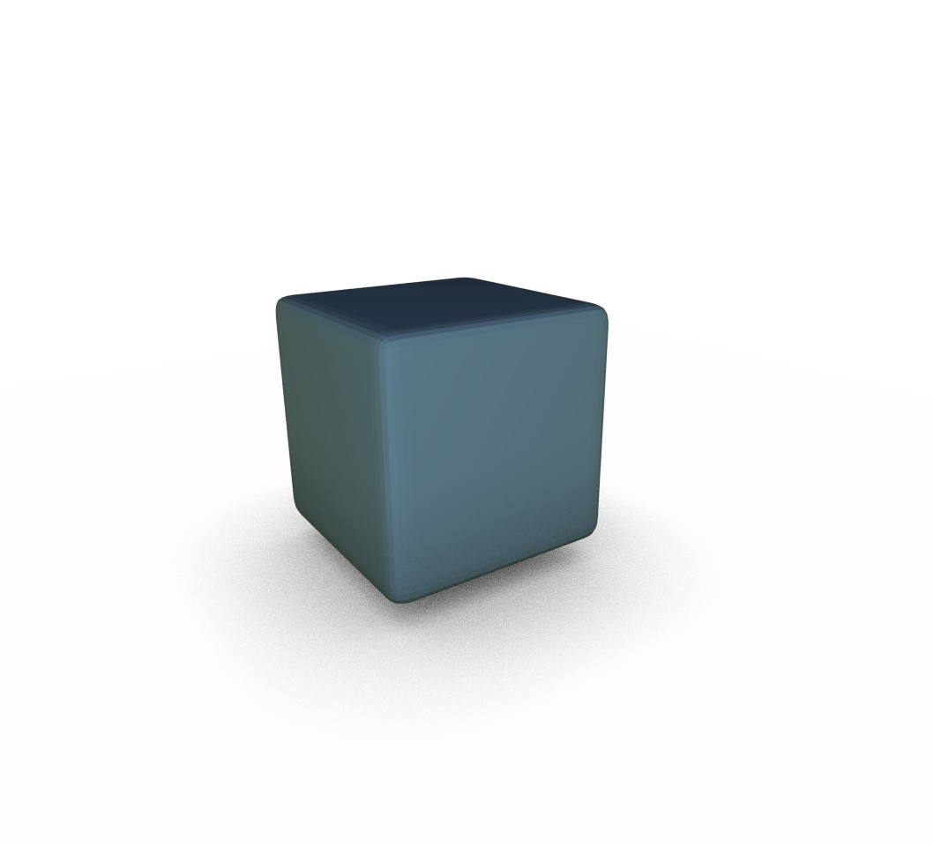
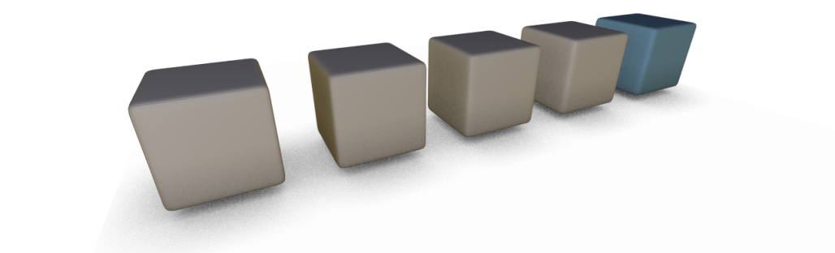
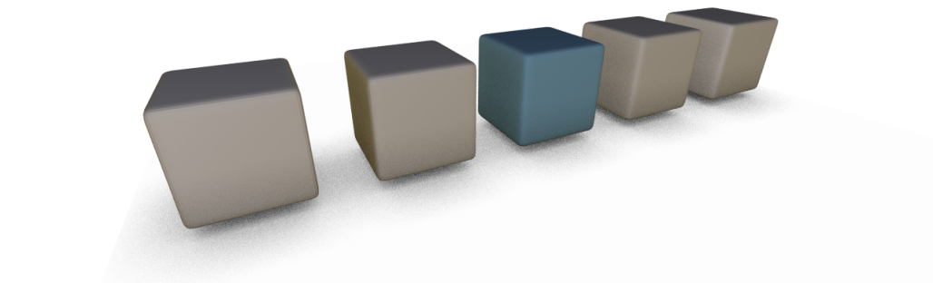
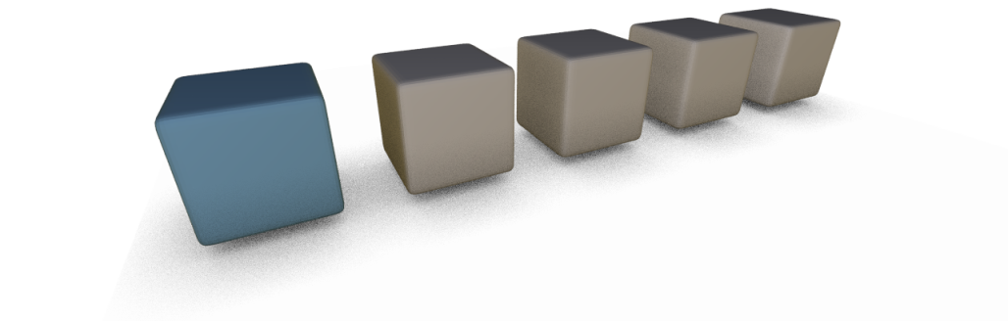







Transformation Groups
Global symmetries
  Closed groups of $T$s
Partial symmetries
$$T^{3}$$
$$T_{2}$$
$$T_{1}$$
$$T^{2}$$
$$T_{3}$$
$$T$$
Notes:
What is well understood, are global symmetries. The Ts inducing them form closed algebraic groups.
However the transformations inducing the pairwise correspondences do not have a closed algebraic structure. Otherwise, T^3 would produce a valid self-correspondence – obviously not the case.

Slide 7
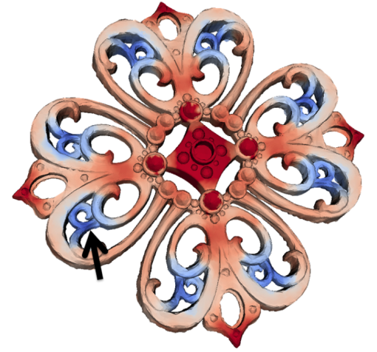
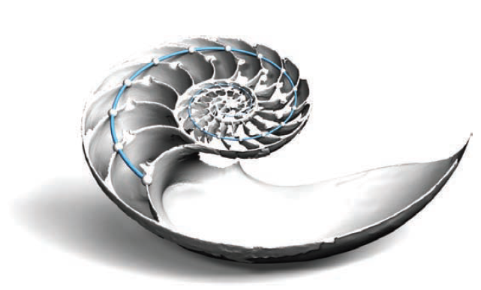
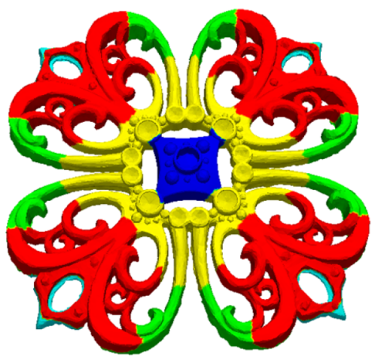
Related Work
Mitra et al.
  Transformation space clustering
Pauly et al.
  Regular patterns in transformation space
Lipman et al.
  Point-wise symmetry aware distance
Notes:
Here is the place to say, that this work is not the only approach that aims at characterizing partial symmetries.
Mitra et al. as well as Pauly et al. propose algorithms that detect partial symmetries based on analyzing the properties of the transformations that induce them.
Lipman et al. introduce a robust point-wise symmetry factored distance metric, which they compute directly from correspondences.
In all papers a segmentation of the shape into parts is proposed, but this segmentations are based on region growing, which makes them to some extent arbitrary. Also, the authors focus on extracting the symmetries, while in our work, we aim at understanding the structure of the segmentation.

Slide 8
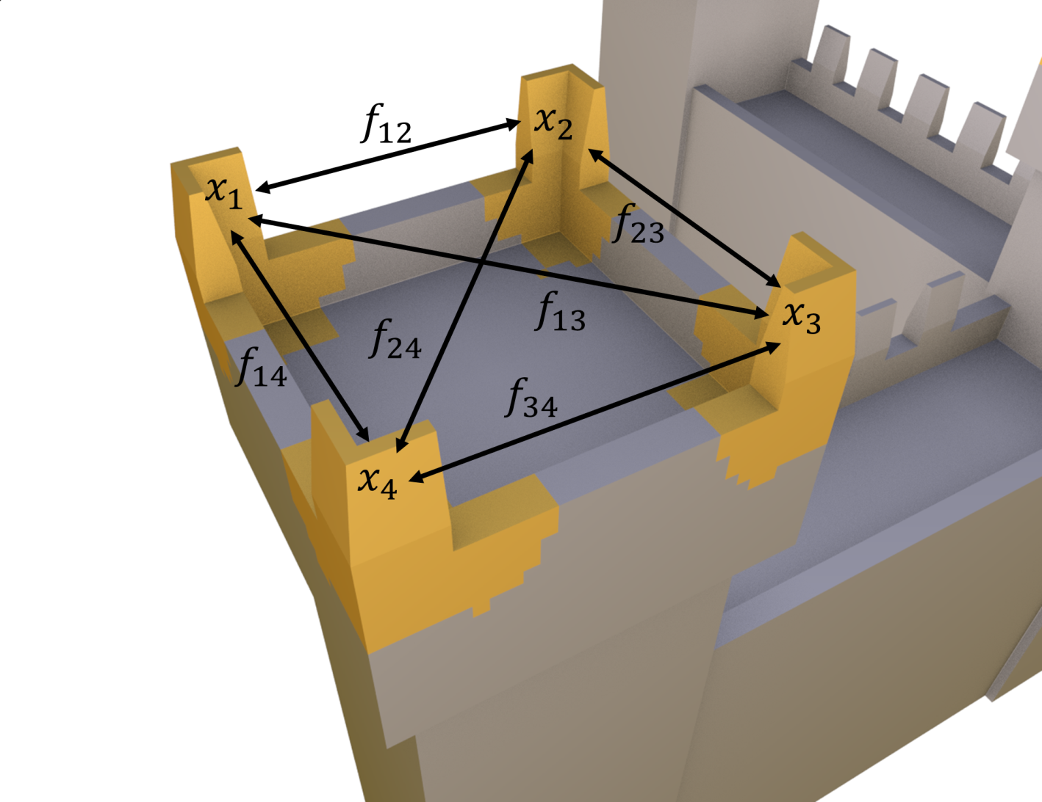
Problem
Input
  A geometric shape
  Point-wise partial correspondences
    Partial symmetries
Output
  Characteristic
  building blocks
Notes:
The problem statement is as follows.
We are given a geometric shape and a set of point-wise correspondences or partial symmetries.
In the figure all yellow points are defined as corresponding to each other via rigid mappings marked as arrows.

Slide 9

Assumptions
Point-wise equivalence relation
  Reflexive: $x_{i}≡x_{i}$
  Symmetric: $x_{i}≡x_{j}⇒x_{j}≡x_{i}$
  Transitive: $x_{i}≡x_{j}, x_{j}≡x_{k}⇒x_{i}≡x_{k}$
Connectivity is
preserved
  Homeomorphisms
Notes:
For the model to work, we impose two important restrictions on the input correspondences.
First of all, the set of mappings should induce an equivalence relation. That is, each point corresponds to itself, the mappings are symmetric and transitive. Note that this restriction is not on each individual mapping.
The second restriction is that the mappings should preserve connectivity. Homeomorphisms have this property, as well as rigid mappings.

Slide 10
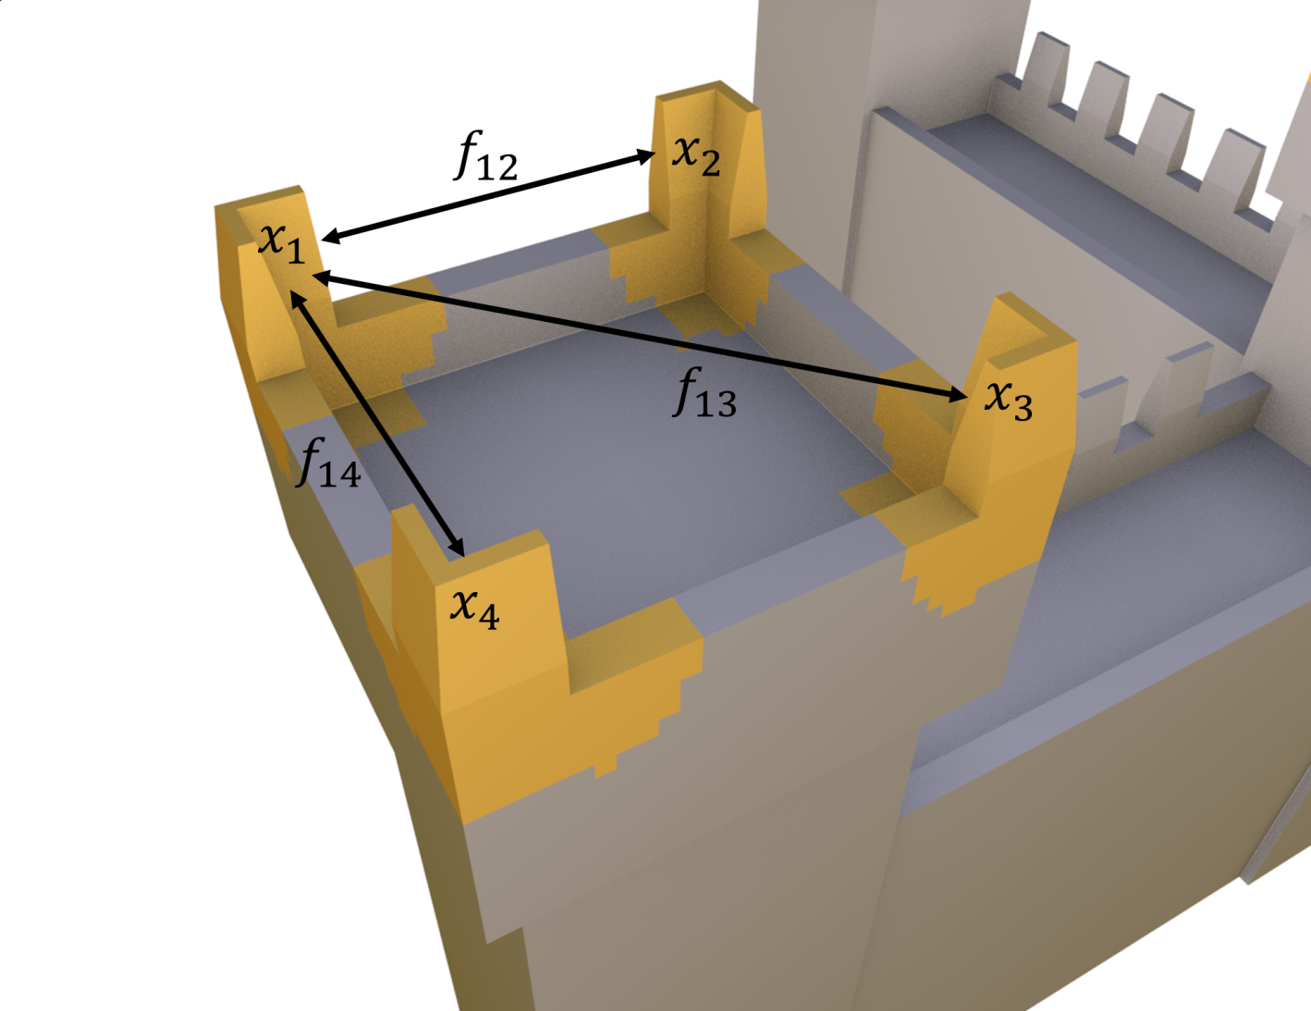
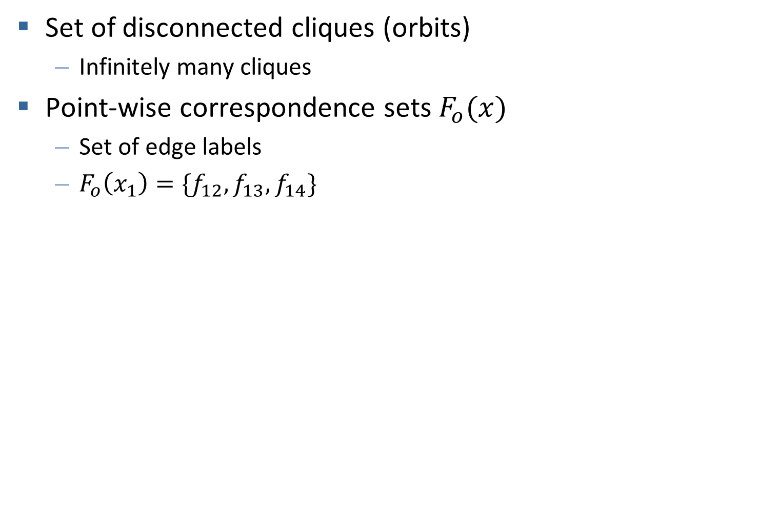
Correspondence Graph Properties
Set of disconnected cliques (orbits)
  Infinitely many cliques
Point-wise correspondence sets$F_{o}(x)$
  Set of edge labels
  $F_{o}\left(x_{1}\right)=\{f_{12}, f_{13},f_{14}\}$
Notes:
Let us now consider the correspondence graph depicted in the figure. It has infinitely many vertices and cliques – one for each yellow point that we can substitute for x.
While those cliques already provide a decomposition of the surface it is not very practical. But we can do better. We consider the set of labels for all outgoing edges at each node or point, and use this set of labels to define what is a microtile.

Slide 11

Microtiles – Instances and Classes
Microtile (definition)
  Connected set of points
  Same set of mappings
Microtile classes
  Equivalent microtiles
Notes:
Repeat: microtiles are points that are always mapped together

Slide 12
Properties
Existence and uniqueness
Disjoint
No partial correspondences between tiles
Encode all symmetries
Algebraic model: permutation groups
Notes:
Exchanging the pieces is the regularity! Not the transformations by themselves. (reformulate!)
Microtiles represent all symmetry properties -> how pieces of the shape are connected via transformations.

Slide 13
Understanding Inverse Procedural Modeling
Part II

Slide 14
Overview
Compute rules, describing a class of similar models
Bokeloh et al. [2010]
Output
Input
Notes:
In their paper, the authors use partial symmetries to cut the input object into pieces that are used to construct a context-free grammar for construction of similar models.
And similar is defined as follows…

Slide 15
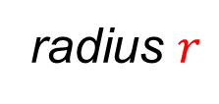



$r$-Similarity
  Local neighborhoods match exemplar
radius $r$
radius $r$
radius $r$
Output
Input
Notes:
For each point in the output model and its neighborhood of radius r, there is a point with the same r-neighborhood in the input model.
Here r is a user-defined parameter.
This notion of similarity directly leads to a specific set of correspondences, we need for our microtiles.

Slide 16
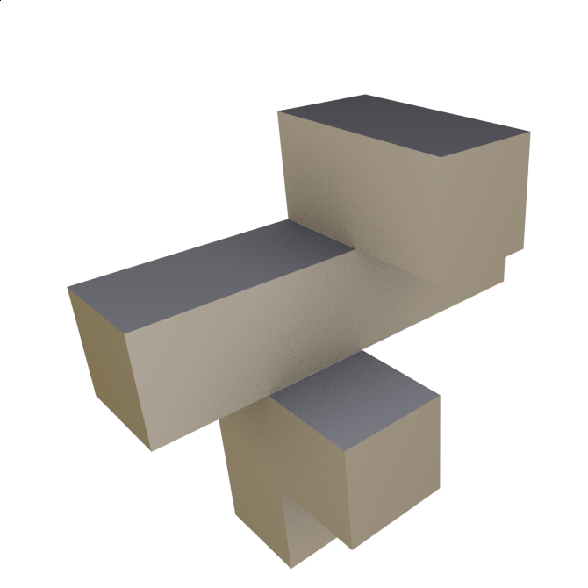
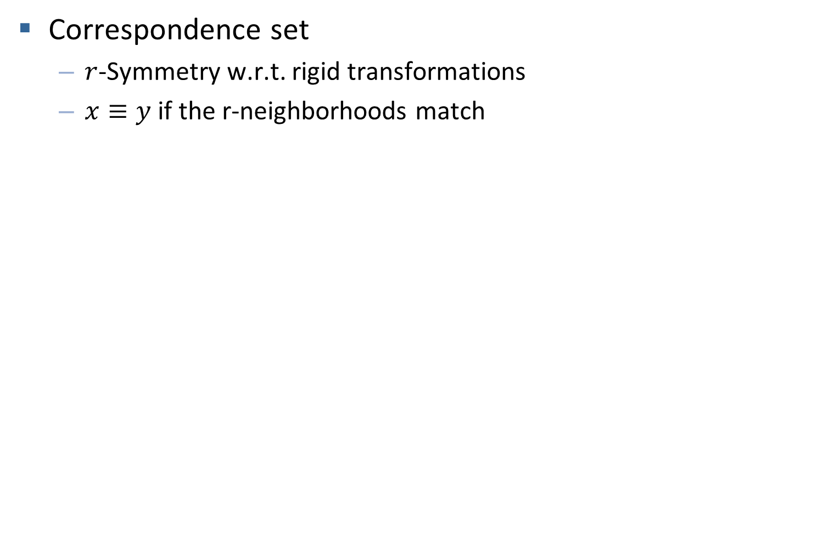

$r$-Symmetry
Correspondence set
  $r$-Symmetry w.r.t. rigid transformations
  $x≡y$ if the r-neighborhoods match
Notes:
Two points are corresponding (or equivalent) if there is a rigid transformation that maps their respective r-neighborhoods to each other.
We have to consider a special kind of correspondences.

Slide 17

Continuous Symmetries
$r$-Slippable points
  Infinitely many equivalent points
Gelfand and Guibas [2004]
Notes:
Namely we can have continuous symmetries or slippable points. You can find all details about them in the paper by Gelfand and Guibas.
Here we only need to consider two types of r-slippable neighborhoods:
Along the edges we can have points r-slippable in one direction and on planes we get 2-slippable points.
In both cases we have infinitely many eqivalent or corresponding points, which need to be treated separately.

Slide 18
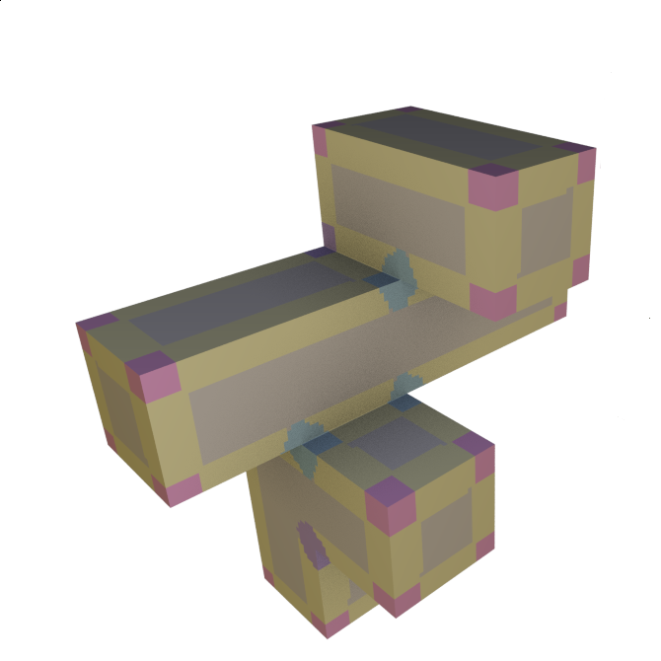
Microtiles
1-slippable
2-slippable
Notes:
The r-slippable points belong to r-slippable microtiles that can be a single point, or a curve segment. The remaining microtiles are mapped to finitely many counterparts.
Here you see a microtile decomposition where equivalent microtiles are colored the same way.

Slide 19
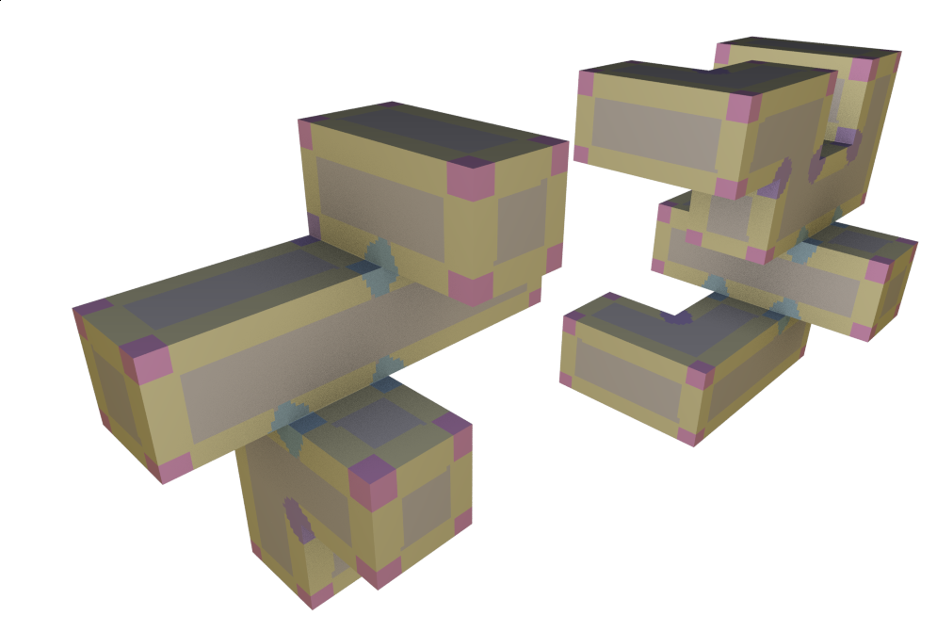

The Space of r-Similar Shapes
Theorem: Given a shape S, all $(r+ε)$-similar shapes to S can be constructed out of the $r$-microtiles of S
Unique construction
Notes:
The main contribution of our paper is showing that the microtiles w.r.t. r-similarity describe the space of r-similar shapes.
That is, given a shape S, we prove that all shapes that are r+eps-similar to S can be constructed from the microtiles of S.
For example the shape on the right is r-similar to the shape on the left and therefore has the same microtiles (or the same colors).

Slide 20
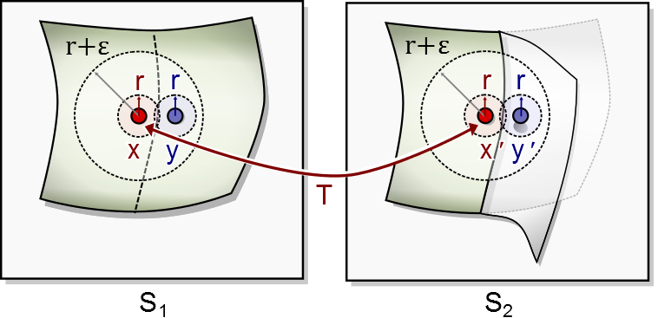

Proof Outline
Show that tile boundaries remain invariant
  $(r+ε)$- similarity implies 𝑟-similarity at tile boundaries
Notes:
The proof follows almost immediately from the definition of r-symmetry and the microtile properties.
Because both shapes are similar for every x’ in S2 we can find symmetric point x in S1. We have to show that the whole tile of x is mapped to a single tile in S2.
If we assume that this is not the case, this means that only a part of the tile matches the new shape. The extended radius of similarity implies that the tile in the exemplar surface has a partial match to another tile, which cannot happen, because microtiles do not have partial correspondences.
In the paper we also discuss when is it possible to let epsilon go to 0, in order to analyze r-similar shapes directly. In our implementation we could safely disregard this additional parameter.

Slide 21

Towards a Shape Grammar
Constraint for construction of shapes $r$-similar to S
  Microtile adjacency has to be present in S
Necessary for $(r+ε)$-similarity
Sufficiency not yet shown

Slide 22
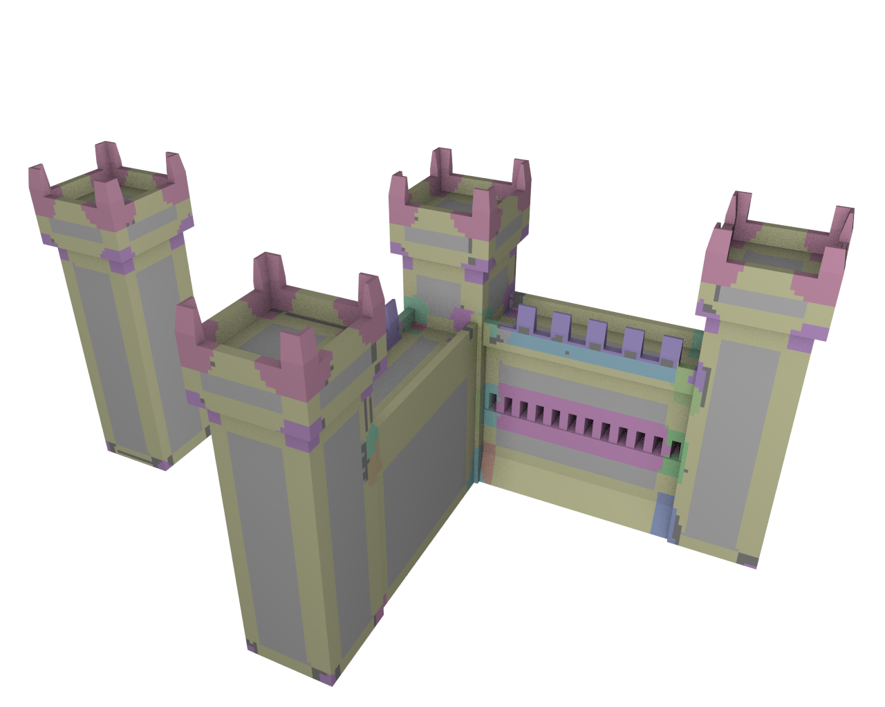
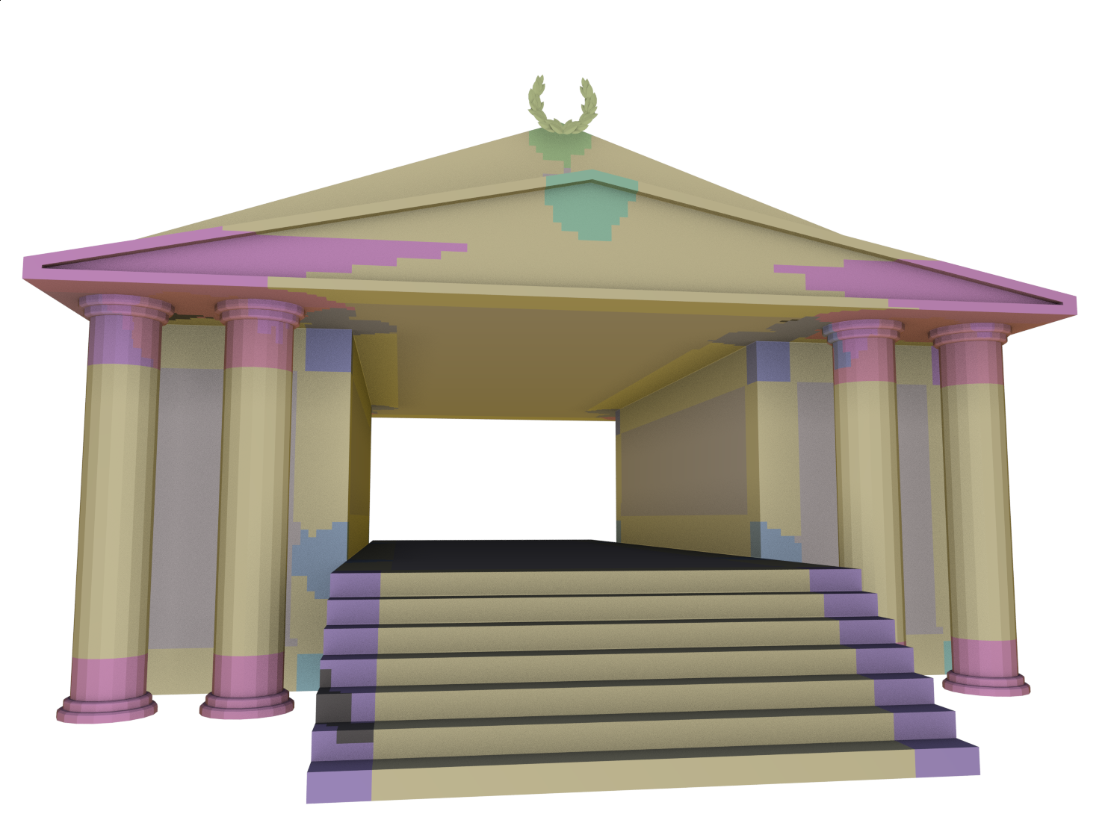
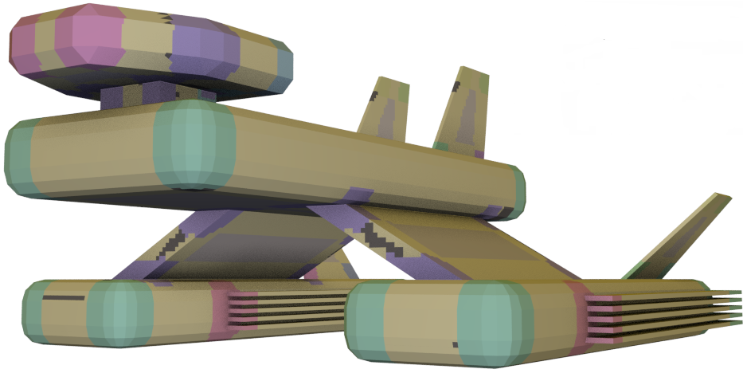
Results

Slide 23
Conclusion
Structure for partial symmetries
  Cannonical
  Encodes all symmetries
  Tiles do not match partially
  Maximal permutation groups
Connection to inverse procedural modeling
  Describes all r-similar shapes
  Pairwise assembly
  Unique construction

Slide 24
Limitations & Future Work
Extraction
  Robust and scalable
  Ill-posed problems e.g. noisy scans
Applications
  Shape understanding
    Instatiation patterns
  Generating new shapes
    Constructive rules (grammar)
Notes:
We want to make a robust implementation, the current one is just a proof of concept.
In addition we want to interpret ambiguous data for example scans. This is a more difficult problem, because we will have to find the simplest decomposition explaining the data.
We want to understand how to create shapes from microtiles constructively.

Slide 25
Thank You!

Slide 26
Goal
Input
  A geometric shape
  Point-wise partial correspondences
    Partial symmetries
Output
  Characteristic
  building blocks

Slide 27
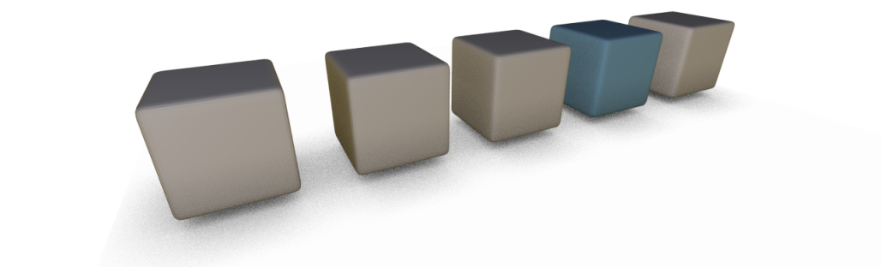
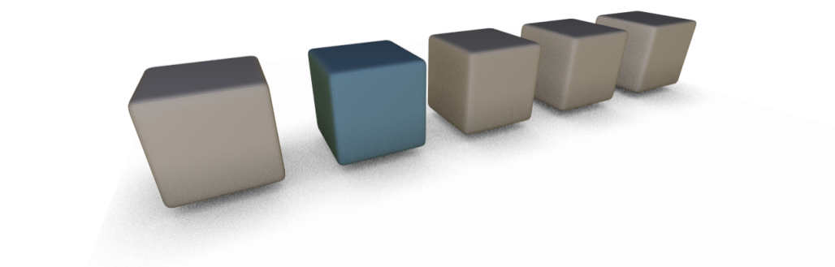



Transformation Groups
Global symmetries
  Closed groups of $T$s
Partial symmetries
$$T^{3}$$
$$T_{2}$$
$$T_{1}$$
$$T^{2}$$
$$T_{3}$$
$$T$$
Notes:
What is well understood, are global symmetries. The Ts inducing them form closed algebraic groups.
However the transformations inducing the pairwise correspondences do not have a close algebraic structure. Otherwise, T^5 would produce a valid self-correspondence – obviously not the case.

Slide 28
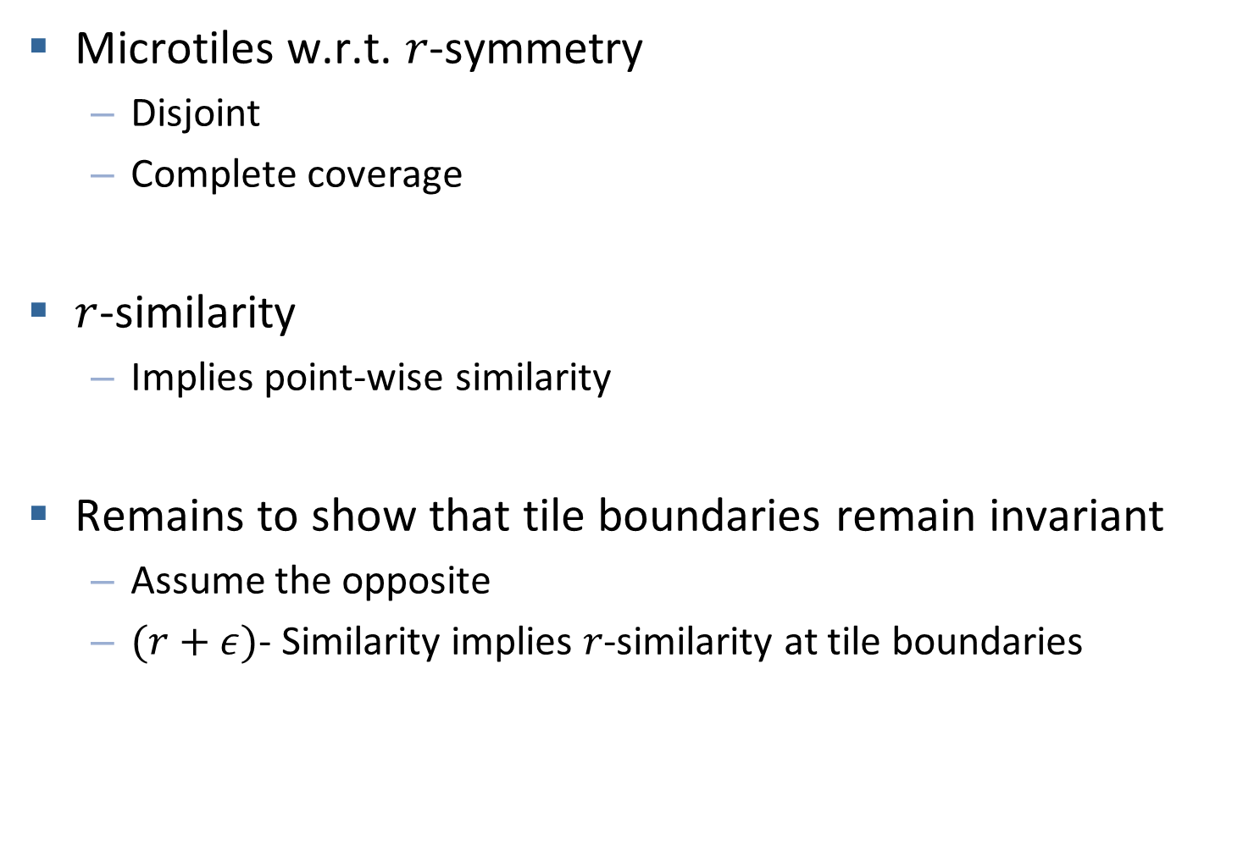
Proof Outline
Microtiles w.r.t. 𝑟-symmetry
  Disjoint
  Complete coverage
$r$-similarity
  Implies point-wise similarity
Remains to show that tile boundaries remain invariant
  Assume the opposite
  $(r+ε)$- Similarity implies 𝑟-similarity at tile boundaries
Notes:
The proof follows almost immediately from the definition of r-symmetry and the microtile properties.
The only non-trivial part is to show that the tile boundaries of the similar exemplar match those in the first shape.
We assume the opposite and reach a contradiction because r+eps-similarity of points on both sides of the new boundary. This is the only place where we need to extend the radius of symmetry by extra eps.
In the paper we also discuss when is it possible to let epsilon go to 0, in order to analyze r-similar shapes directly. In our implementation we could safely disregard this additional parameter.

