Slide 1
Building Construction Sets by
Tiling Grammar Simplification
Javor Kalojanov, Michael Wand, Philipp Slusallek

Slide 2
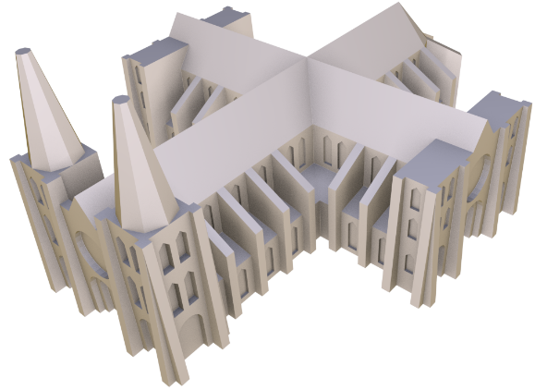
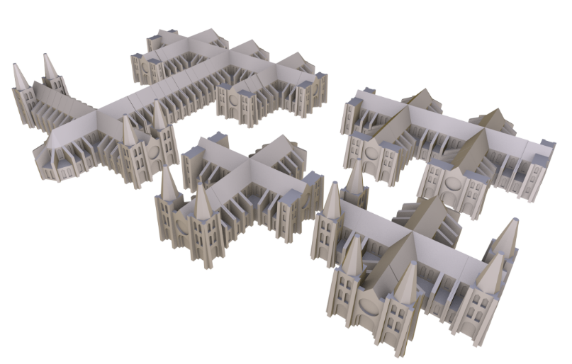
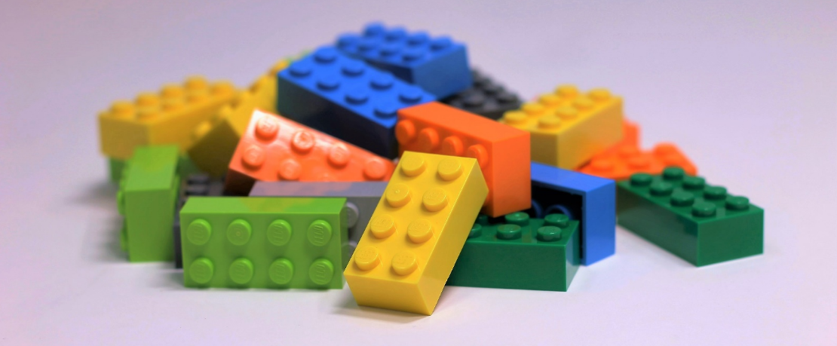
Computing Construction Sets
Given or
Can we compute (optimal) building blocks?
  rigid, fit together, can be assembled, construct multiple shapes
Notes:
Problem statement: Given a shape or a set of shapes that we want to physically manufacture, can we automatically compute a set of building blocks that can generate them?
What makes for a good set of such constructor pieces? As this turns out to be a difficult problem to solve fully automatically, we stick to the essential properties of such constructor pieces.
Rigid so we can make them using non-elastic materials. Fit together and possible to assemble are not the same thing as we will se later on, and we obviously need both properties. Finally, we want to construct multiple shapes with the same set of pieces.
Out of these properties the last one is arguably the most interesting.

Slide 3
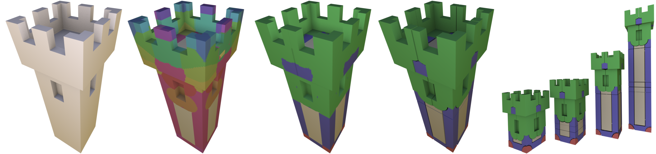
Inverse Procedural Modeling and Microtiles
Part I
Notes:
In the first part of this talk we will discuss Inverse Procedural Modeling, which deals with the problem of automatically generating 3D models. Our paper is about applying one of these methods to create physically manufacturable building blocks for shape creation.

Slide 4
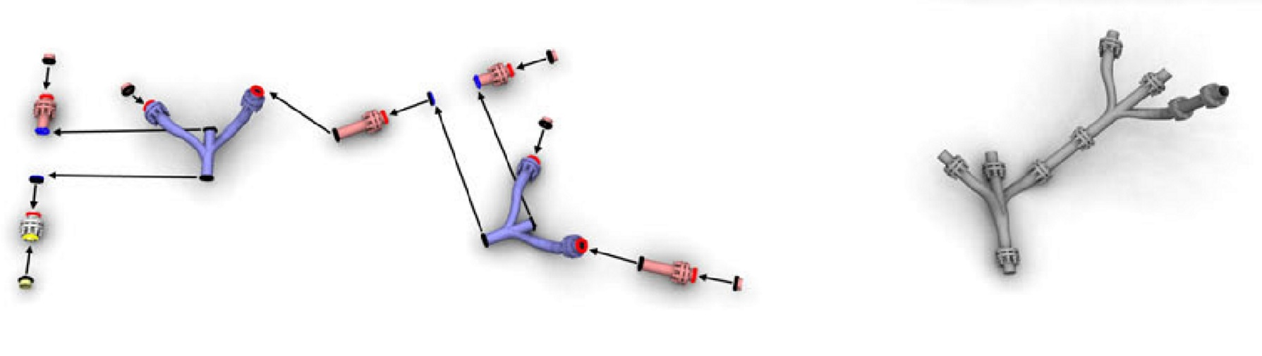
Shape Grammars
Context free grammars Tiling grammars
[Bokeloh et al. 2010]
Notes:
Generating a large number of related shapes from a few pieces is typically done using shape grammars.
These are a geometric analogue to formal grammars with literals mapped to building blocks, and words mapped to shapes, and allow to create large families of shapes from just a few parts.
An uncommon aspect of our method w.r.t. shape grammars is that compared to the most of the related approaches based on context-free grammars, we use a more general type of grammar.
The advantage of context-free grammars, and the reason why these are typically used in procedural modeling applications is that they are hierarchical and easy to understand and use for shape creation.
On the other hand, tiling grammars are easier to compute automatically and allow greater variability. In the example, the tiling grammar can create both taller and wider buildings, while achieving this with a context free grammar is usually done through user-specified additional parameters.

Slide 5
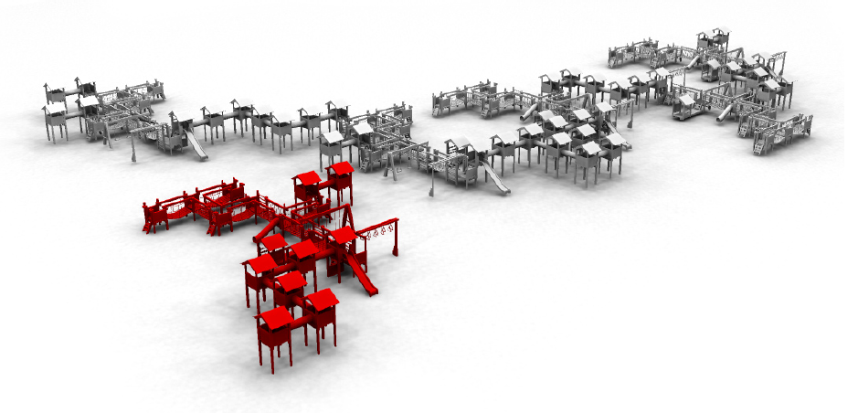
Inverse Procedural Modeling
Compute a shape grammar from an example
Output
Input
[Bokeloh et al. 2010]
Notes:
Thanks to previous work, we know how to automatically decompose objects (triangle meshes) into a set of pieces and assembly rules that form a shape grammar.
The work by Bokeloh et al. in particular, computes context-free grammars for creation of a certain type of shape variations. The new shapes have the following property…

Slide 6

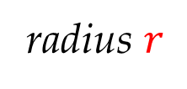
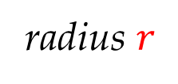

$r$-Similarity
Local neighborhoods match exemplar
radius $r$
radius $r$
radius $r$
Output
Input
[Bokeloh et al. 2010]
Notes:
For each point in the output model and its neighborhood of radius r, there is a point with the same r-neighborhood in the input model.
Here r is a user-defined parameter.
For each choice of r and each input model, there is a (usually infinite) set of r-similar shapes. As a side note – because Bokeloh et al. use context free grammars, they can construct a sub-set of these shapes. However, thanks to a follow up work we know how to compute a tiling grammar that characterizes the complete space of models that are r-similar to the input.

Slide 7
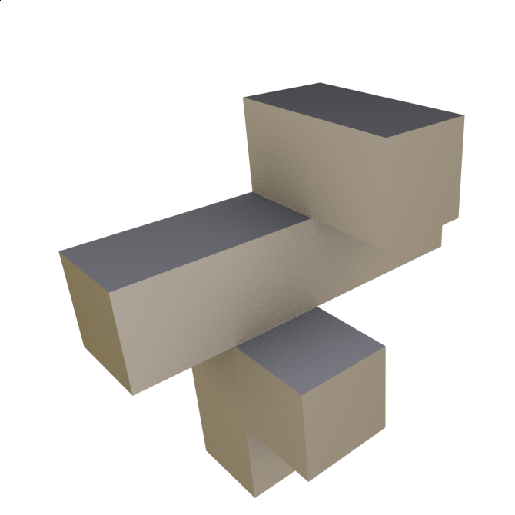

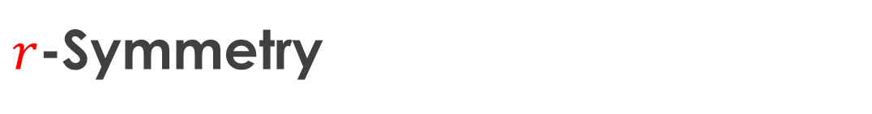
$r$-Symmetry
A set of correspondences
  $r$-Symmetry w.r.t. rigid transformations
  $x≡y$ if the r-neighborhoods match
Notes:
How can we automatically compute a tiling grammar for an input shape?
The idea behind our inverse modeling approach is to consider a set of point-wise correspondences – r-symmetry.
Two points are symmetric or equivalent if the spherical r-neighborhood of one of the points can be mapped identically to the other point via a rigid transformation. Rigid r-symmetry matches well the application scenario since we want to create non-deformable building blocks.
Note that the correspondences are defined per inifinitely-small points. This makes the correspondences along edges and inside planes difficult to analyze. There, points and their neighborhoods can be continuously shifted along 1 direction or freely on a plane without change. We will call these points 1- or 2-slippable.

Slide 8
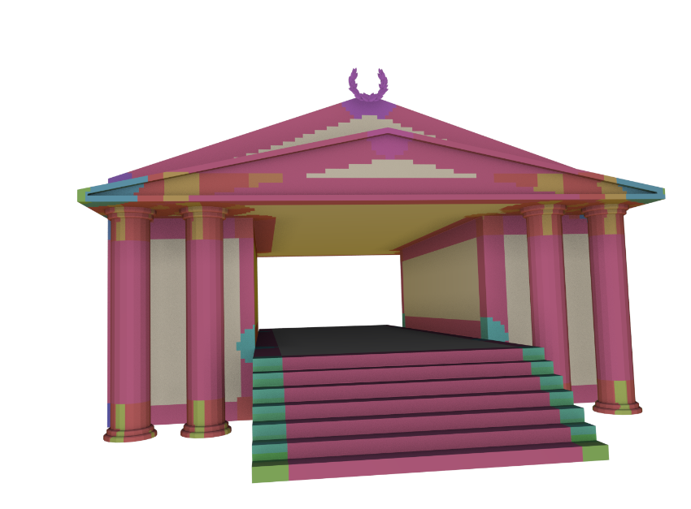
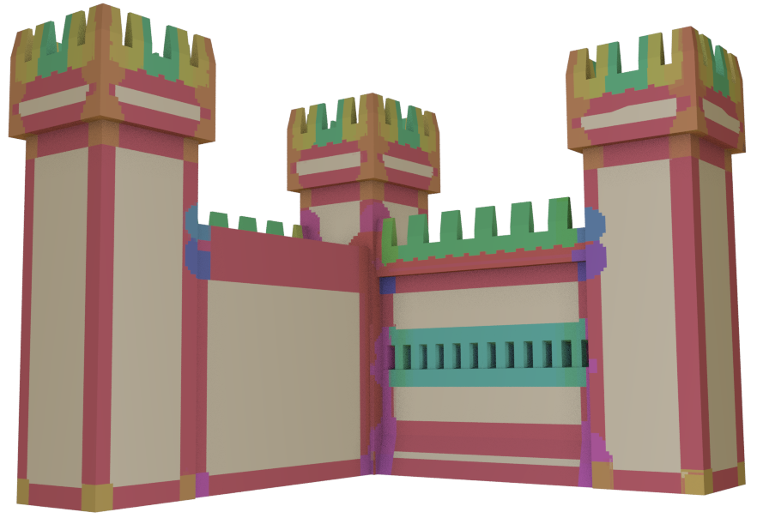
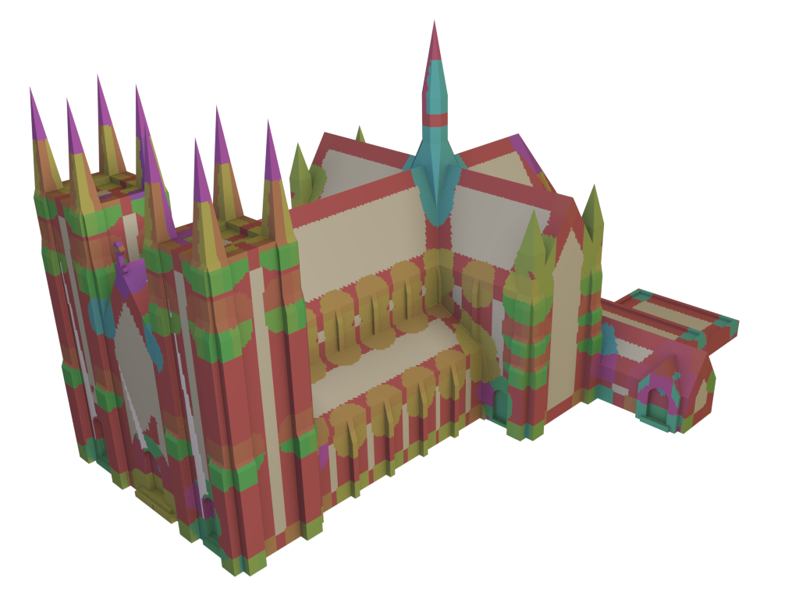
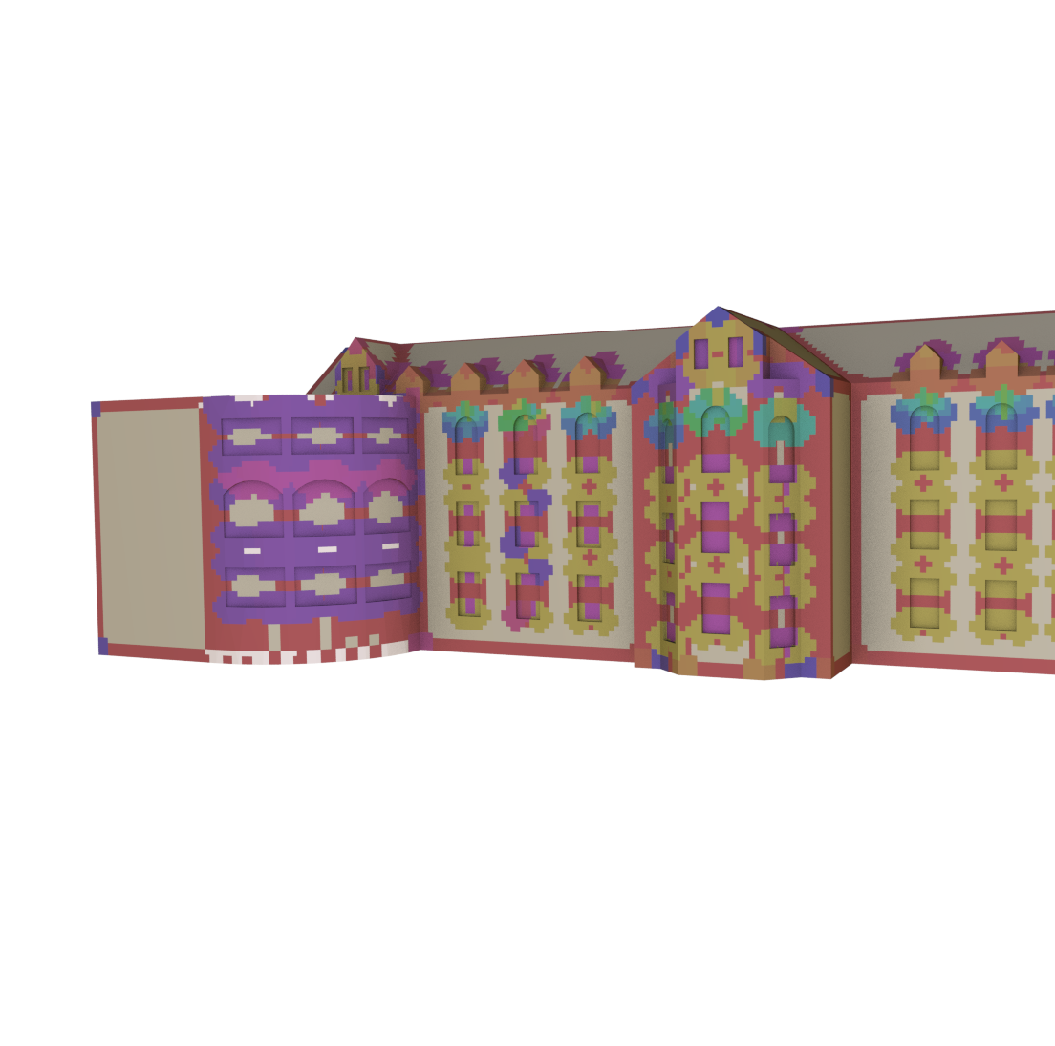

Microtiles
Tiling grammars for $r$-symmetry
[previous work]
Notes:
We call the tiling grammar we use here “microtiles”. It is the decomposition of a shape into its partial r-symmetries.
We take an input model, find all pairs of r-symmetric points. These are inside spherical neighborhoods that can be mapped identically via a rigid transformation and can therefore be interchanged. Next we segment the model along the boundaries of the symmetric regions.
Here are some examples, where identical pieces are colored identically.

Slide 9
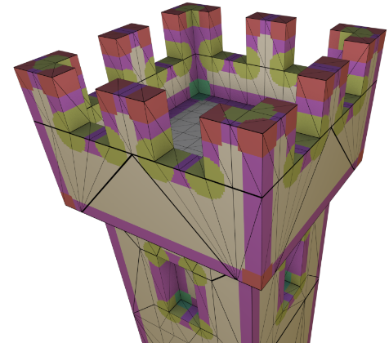
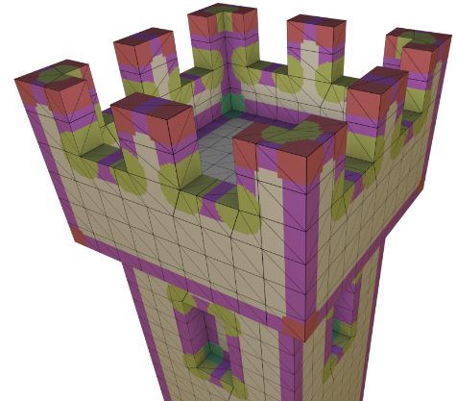
Microtile Properties
Generate all r-similar shapes*
  Encode all partial symmetries
  Very granular
Include slippable pieces
  1-slippable edges
  2-slippable planar regions
Triangulation independent
[previous work]
Notes:
There are several important microtile properties that we need to consider.
First, the microtiles of a shape characterize all shapes r-similar to it. This means that if a shape consists of points r-symmetric to the points our input shape, we can build it with the same set of microtiles. Hence, by decomposing a shape we get a set of building blocks for an entire shape familiy. Also, this is why we do not need to use multiple r-similar input models, we only need to decompose one of them into microtiles.
Note that because of the way we defined symmetry, this decomposition is triangulation independent as you can see in the example. Indeed, changing the triangulation of a model does not change its geometric shape, and therefore the set of microtiles stays the same. This is an advantage because it generalizes our approach, but will create some problems later on.
Another problematic aspect are the 1- and 2-slippable regions. They consist of infinitely small slippable microtiles, which are either a single point with planar neighborhood or a curve segments that you can slide along an edge of the model.
Lastly, the main problem we want to address is the granularity of the decomposition, which is necessary in order to ensure the ability of creating all possible shape variations, but renders it very impractical for actually creating the pieces and putting them together manually.

Slide 10
Graph-Based Tiling Grammar Simplification
Part II
Notes:
In the second part of the talk we will address the problem of simplifying tiling grammars. We will present a general simplification algorithm that can target various applications. We will use it to improve the properties of our building blocks related to manufacturing them and putting them together.

Slide 11
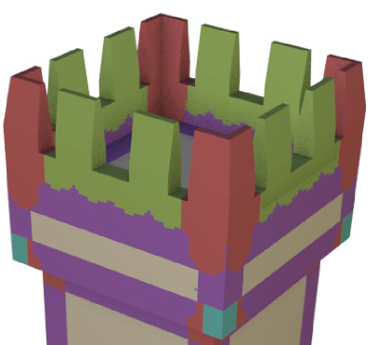
Microtile Graphs
Second-level structure
  Nodes are microtiles
  Spatially neighboring nodes are connected
  Nodes and edges form equivalence classes
Notes:
In order to simplify the initial microtile decomposition easily, we will represent it with a graph structure.
Each node corresponds to a microtile and spatially neighboring nodes are connected. Note that we connect trough slippable edges.
We carry over the symmetry information from the microtiles to the nodes and edges of the graph, i.e. we equivalent nodes represent symmetric microtiles, and equivalent edges connect pairs of equivalent nodes.
Observe, as a side note, that such a graph can be constructed for any symmetry aware decomposition. In other words the structure we consider appears every time a model is created from pieces via copy-paste operations. This makes our method applicable to other types of decompositions.

Slide 12
Edge collapses
Preserve geometry
Collapse symmetry classes
Aggregates segments
  Introduces back redundancies
Notes:
Once we have a microtile graph, we can transform it and with it we modify the initial decomposition. Here, we consider two types of graph transformations.
First, we collapse edges which merges neighboring microtiles into larger segments. In order to preserve the initial symmetry information, we collapse each edge together with all of its equivalent ones.
Note that collapsing graph edges changes the segmentation of the shape into pieces, but the geometry is preserved.

Slide 13
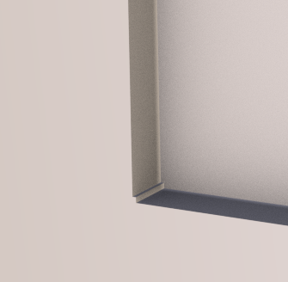
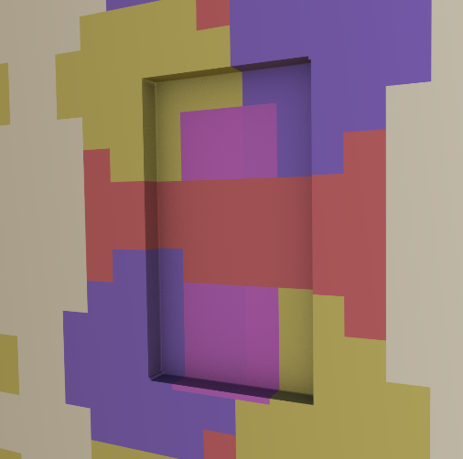
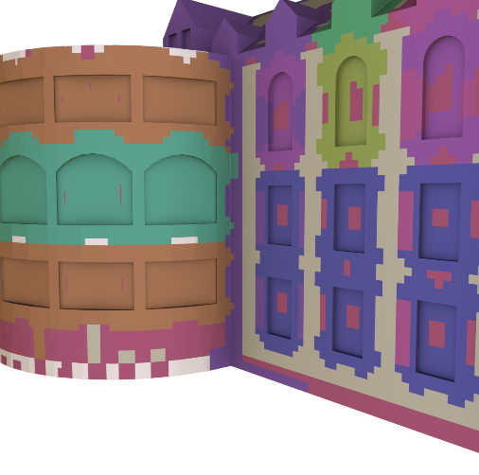
Tile Replacement
Approximate a class/type of tiles with a similar one
After replacement:
Notes:
The second type of operation can change the object slightly. We can check if after performing several merge operations the newly created building blocks from different types become similar. If we discover similar types, we replace the instances of one of the types to further simplify the decomposition.
As a side note: approximate matching and replacement combined with the aggregation from the previous slide, allows to improve the robustness of symmetry detection. Take this model for example, where several window corners have a small deformation, maybe caused by an artist error. By distributing the “symmetry error” over larger area and checking entire windows for symmetry we are able to replace the supposedly defective window with standard ones.

Slide 14
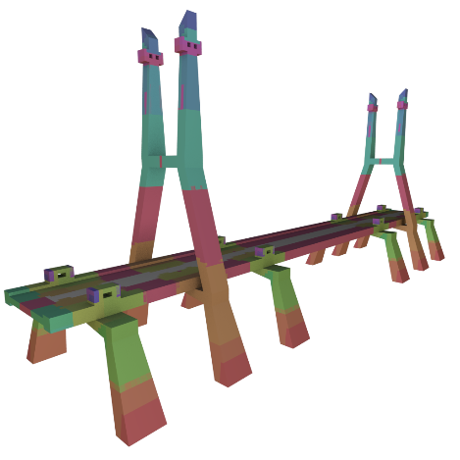
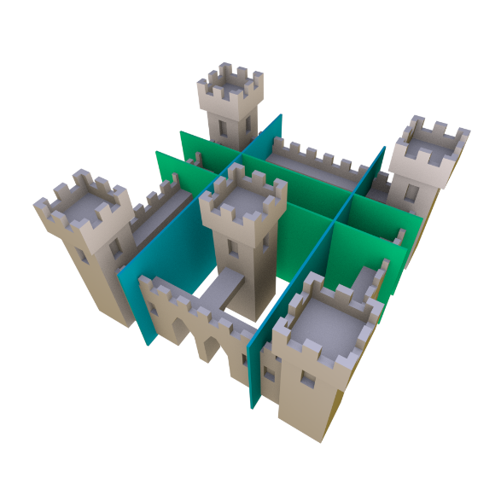
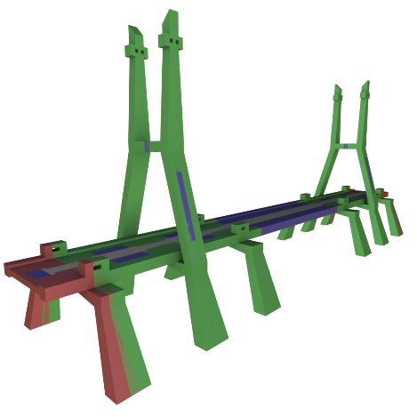
Optimize for 3D Manufacturing
Redundancy (w.r.t. r-symmetry)
  Surface area of microtiles
Global symmetry cuts
  Guarantee shape variations
Simplicity
  Number of microtile types (colors)
Assemblability
  Probability of interlocking components
no redundancy
complex
has redundancy
simple
Notes:
How do we know if a transformed microtile graph yields a better decomposition? Target various applications by designing and optimizing a cost function.
For 3D manufacturing we ended up considering 4 cost terms.
First redundancy. This is the surface area of points that have identical r-neighborhoods to other points but are represented in more than one microtile. We initially have zero redundancy in the decomposition, so this term can be used to limit the amount of simplification. It also corresponds to the amount of shape variations obtainable from the building blocks.
The second term is an additional constraint aimed at ensuring variability. We find and try to preserve pairs of symmetric global cuts. Apart from these we do not have other means to guarantee that creating shape variations will be possible after simplification. Since tiling grammars are touring complete, automatic analysis of the languages generated by them is not feasible.
The third term counterweights the other two. We want to simplify the input constructor set to as few pieces as possible. This makes assembly easier and can be useful in a mass production process like injection molding, where creation of multiple pieces of the same type is cheap, but having variants is expensive.
The last component we had to include is a constraint that has to do with the ability to assemble the constructor pieces after manufacturing them. In order to minimize the chance of creating interlocking components such as those in the figure, we penalize the interfering volumes of neighboring building blocks.

Slide 15
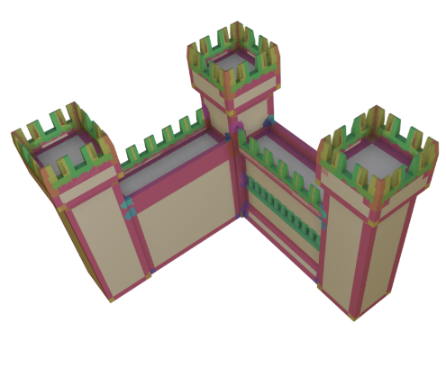
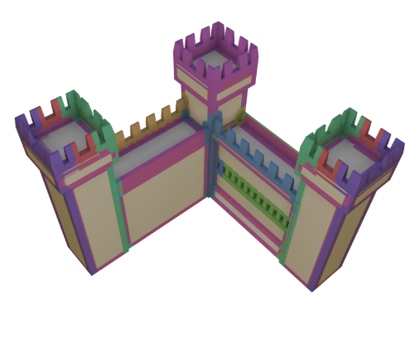
Optimization Considerations
Objective function
  Non-convex, non-continuous
  Cheap evaluation
  Search space is usually small
Random sequences of graph transformations
  Finding global minimum not guaranteed
  Very good results in practice
  Also usable for supervised applications
468 pieces
47 types
14 pieces
9 types

Slide 16
Manufacturable Microtiles
Part III
Notes:
The last problem we need to address before being able to manufacture our building blocks is converting our surface segmentation into precisely cut, volumetric pieces that are invariant under rigid transformations.

Slide 17

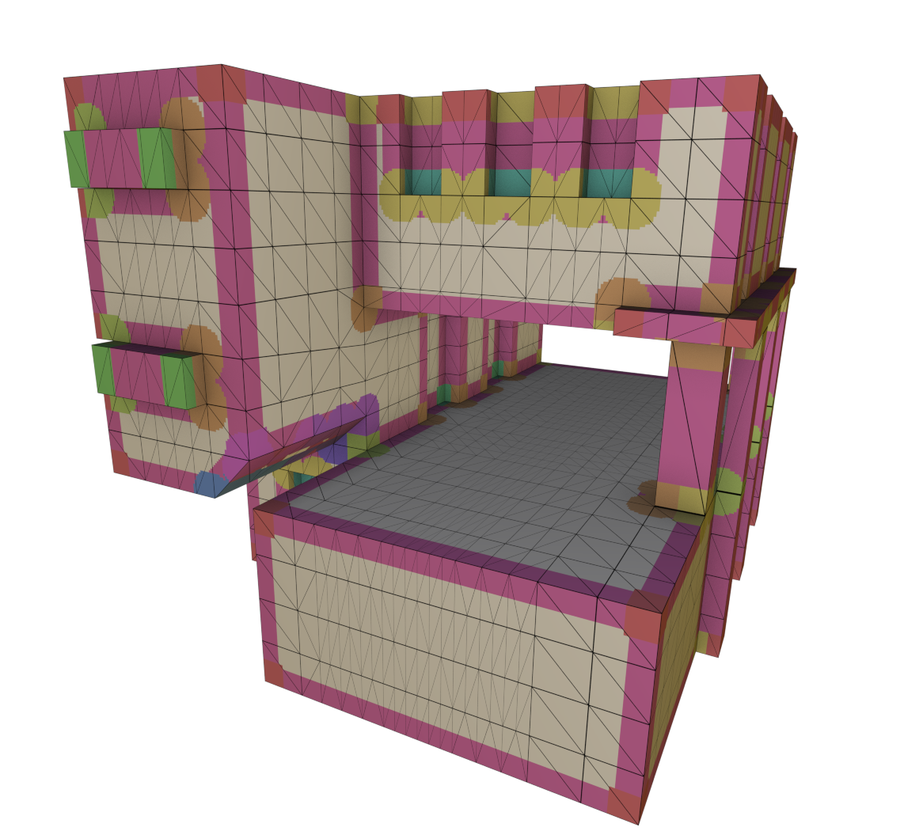
Volumetric Building Blocks
Current segmentation:
  Coarsely voxelized
  Not aligned with the triangle mesh
  Overlaps at boundaries
Notes:
Similar to all previous work on inverse procedural modeling, the representation we have so far is only suitable for creating virtual models, because the building blocks are not precisely separated from each other. This means that they overlap at the boundaries, which is not an issue for a rendering application (except if you color the pieces differently), but makes physically putting two pieces together impossible.
This problem is due to the property that the microtiles are triangulation independent. Because of that, their boundaries are not aligned with the triangle edges and the building blocks are difficult to isolate. What we did until now to visualize the decomposition, was to reuse a relatively coarse voxel grid imposed over the triangle mesh. For each voxel we compute whether it is inside a microtile and choose its color accordingly. If the voxel is inside more than one r-neighborhood, we select the one with center closer to the voxel.
The naïve solution of simply reusing the voxel representation for manufacturing is not practical. Even at high resolution the discretization errors break the invariance under rotations and even translations, which will result into building blocks that do not fit together.

Slide 18
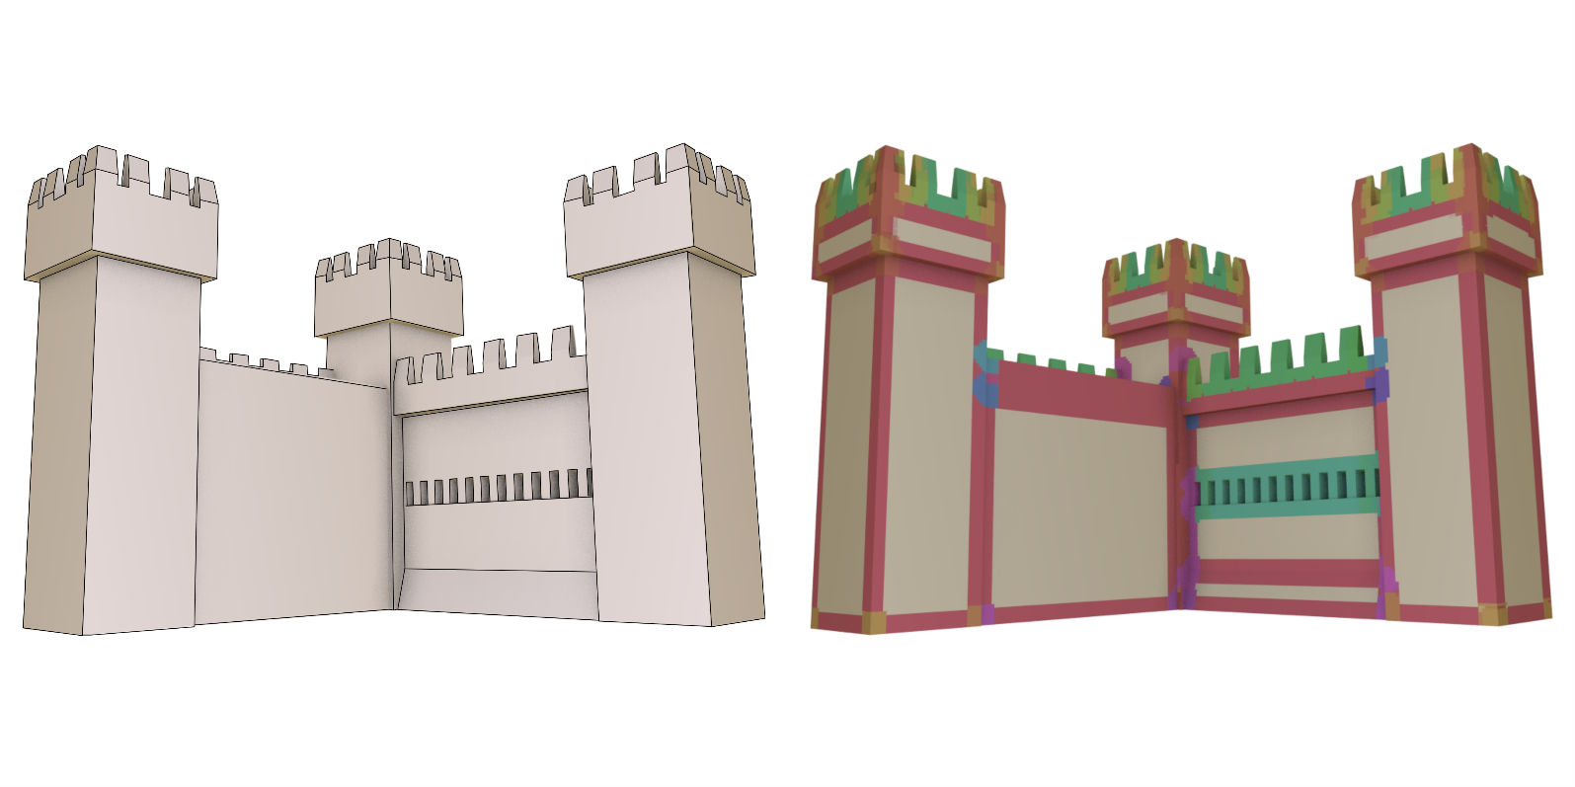
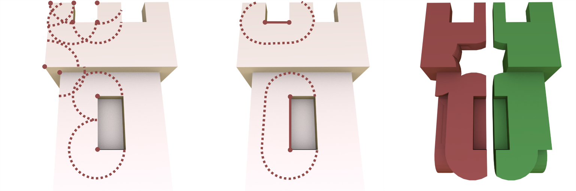
Feature-based Discretization
Microtiles are located at geometric corners and edges
r-Neighborhoods inside a union of spheres and cylinders
corner cutouts
edge cutouts
CSG union cutout
Notes:
The solution, we came up with, relies on two main ideas.
First, we use a special discretization. Instead of the voxels or the triangles, we use the geometric corners and edges. Observe, how in this example all microtiles, apart from the 2-slippable planar pieces are located within a distance r to such a geometric feature. Indeed we can show that the building blocks can be precisely enclosed in a set of spheres around the corner features and cylinders along edges.
The second part of our solution is using exact CSG operations to carve out the building blocks from the model. Again, skipping the details, consider an example set of corner points and edges, we want to include in a building block. In the first two images on the bottom we show which spherical neighborhoods we want to carve out. On the right, in brown, is the result of a CSG intersection of the input model with the union of the spheres and cylinder from the previous two steps. The green piece contains the same neighborhoods, plus two additional cylinder along outgoing edges for beautification.
We implemented this by exporting a script and running it in a CAD tool called Open SCAD. It is based on CGAL and support exact arithmetic, allowing very precise segmentation.

Slide 19
Global Cuts
Splitting slippable geometry
  Infinitely many cuts, but not manufacturable
  Difficult to perform with CSG
  Workaround: use only planes

Slide 20
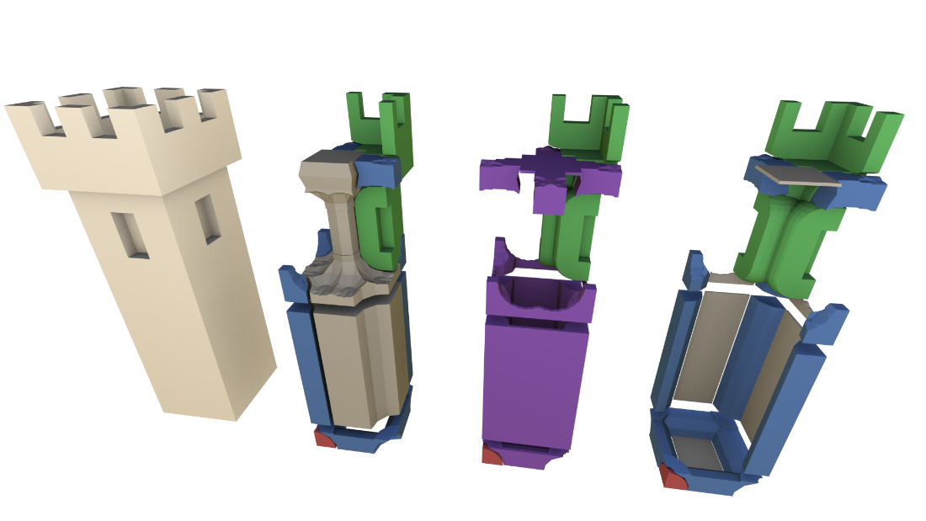
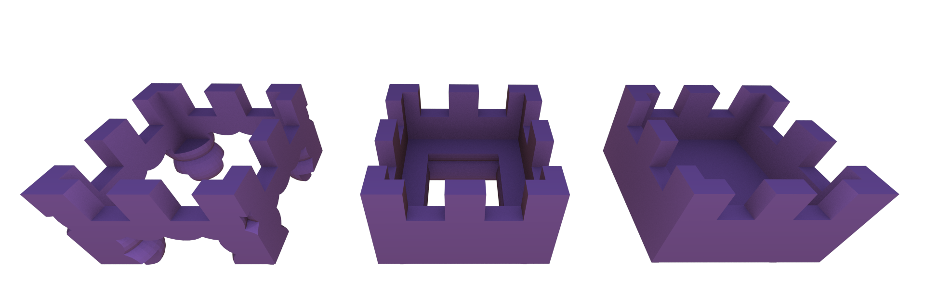
Additional features
Multiple CSG extraction modes
Redundant slippable pieces removal
non-slippable
+ 1-slippable
+ 2-slippable
Notes:
Multiple CSG modes: Merge 1-slippable and 2-slippable pieces or keep inside volume attached to the 2-slippable pieces
Merge 1-slippable and 2-slippable regions to surrounding non-continuous building blocks

Slide 21
EVALUATION

Slide 22
Limitations
Symmetry model
  Only r-similar variations
  Clean input meshes only
Planar global cuts
CSG (OpenSCAD) robustness
Cost model
  Minimal amount of mechanical properties

Slide 23
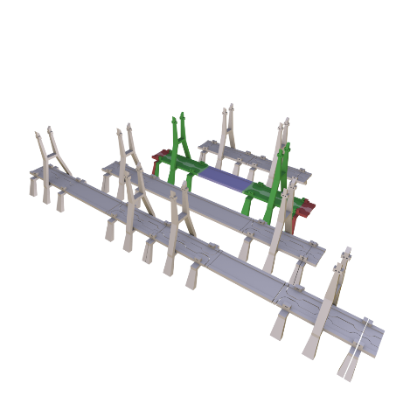
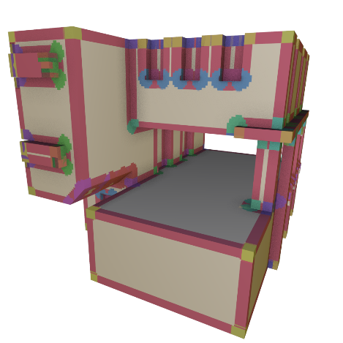
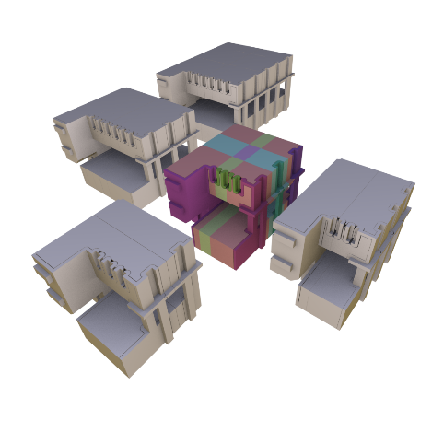
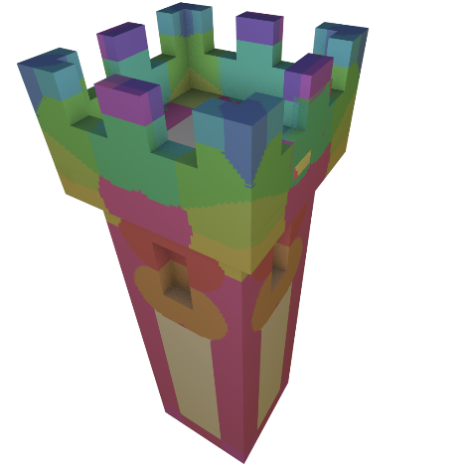
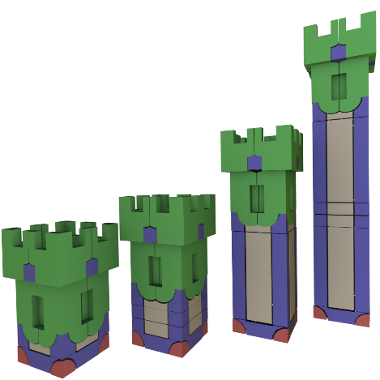
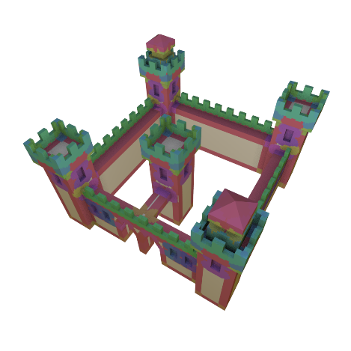
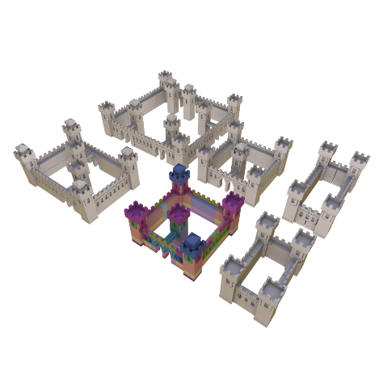
Simplification Results
input
output
232 pieces
15 types
8 pieces
2 types
246 pieces
36 types
27 pieces
11 types
104 pieces
15 types
8 pieces
2 types
693 pieces
53 types
149 pieces
12 types

Slide 24
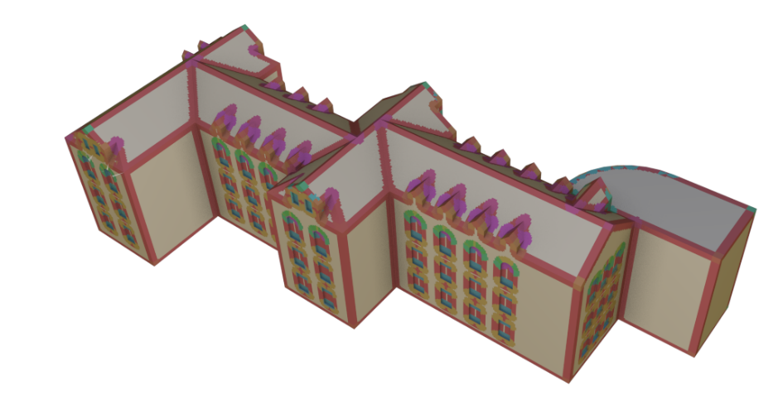
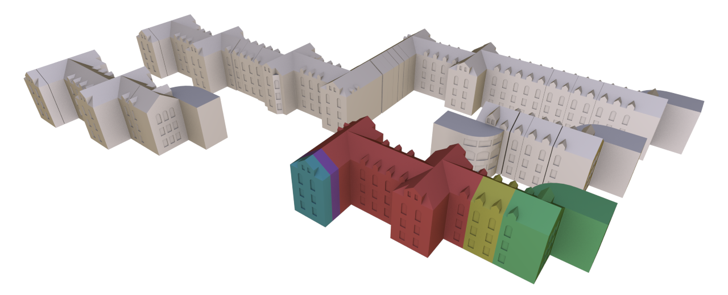
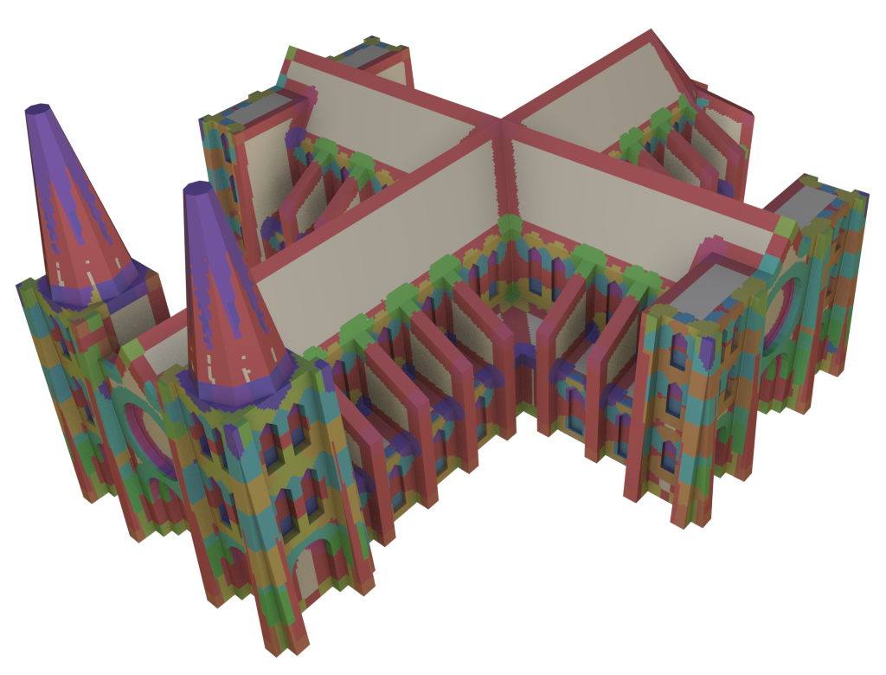
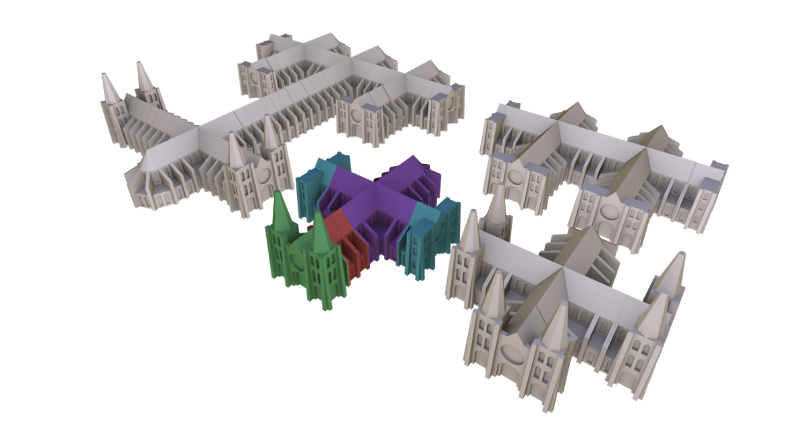
Global Cuts Only
1130 pieces
277 types
81 pieces*
17 types*
2042 pieces
309 types
8 pieces*
4 types*
*statistics for the complete decomposition

Slide 25
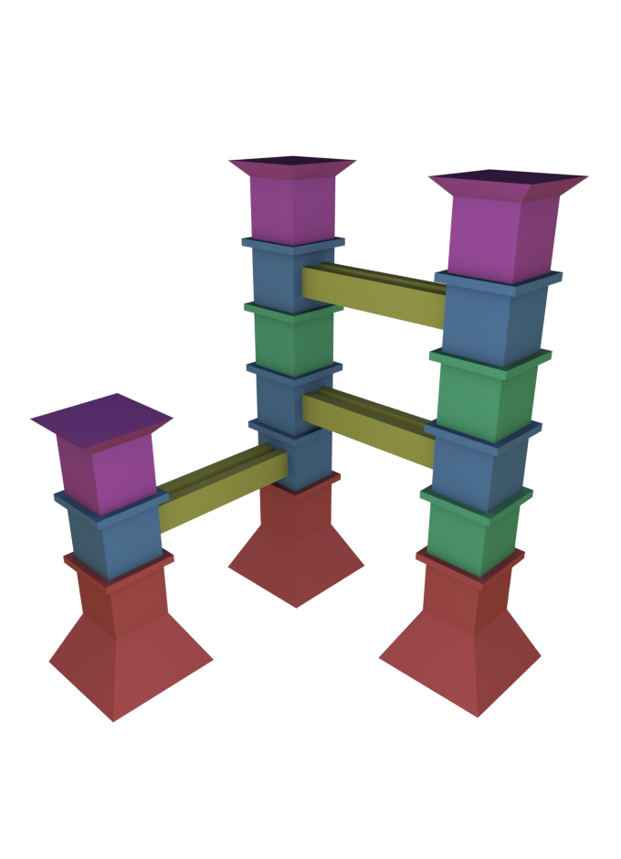
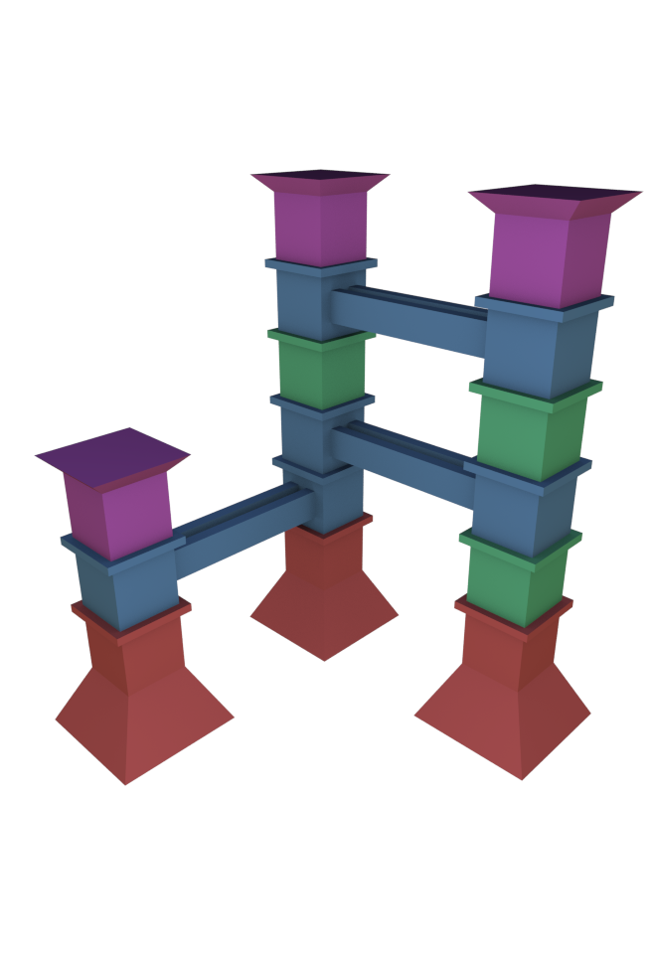
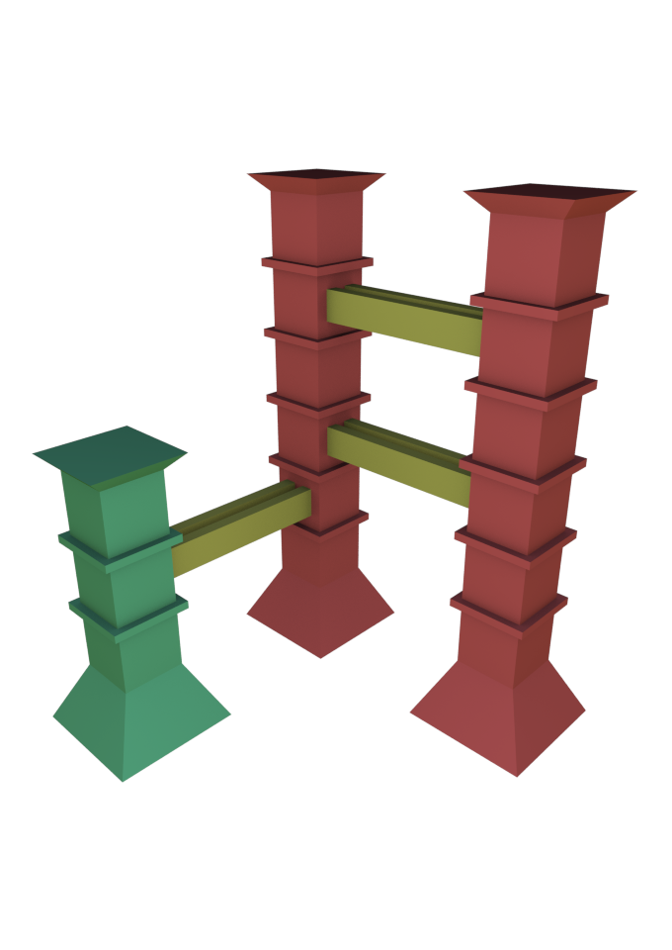
User-defined Segmentations
+ approximate
matching
input
simplified
[Liu et al. 2015]

Slide 26
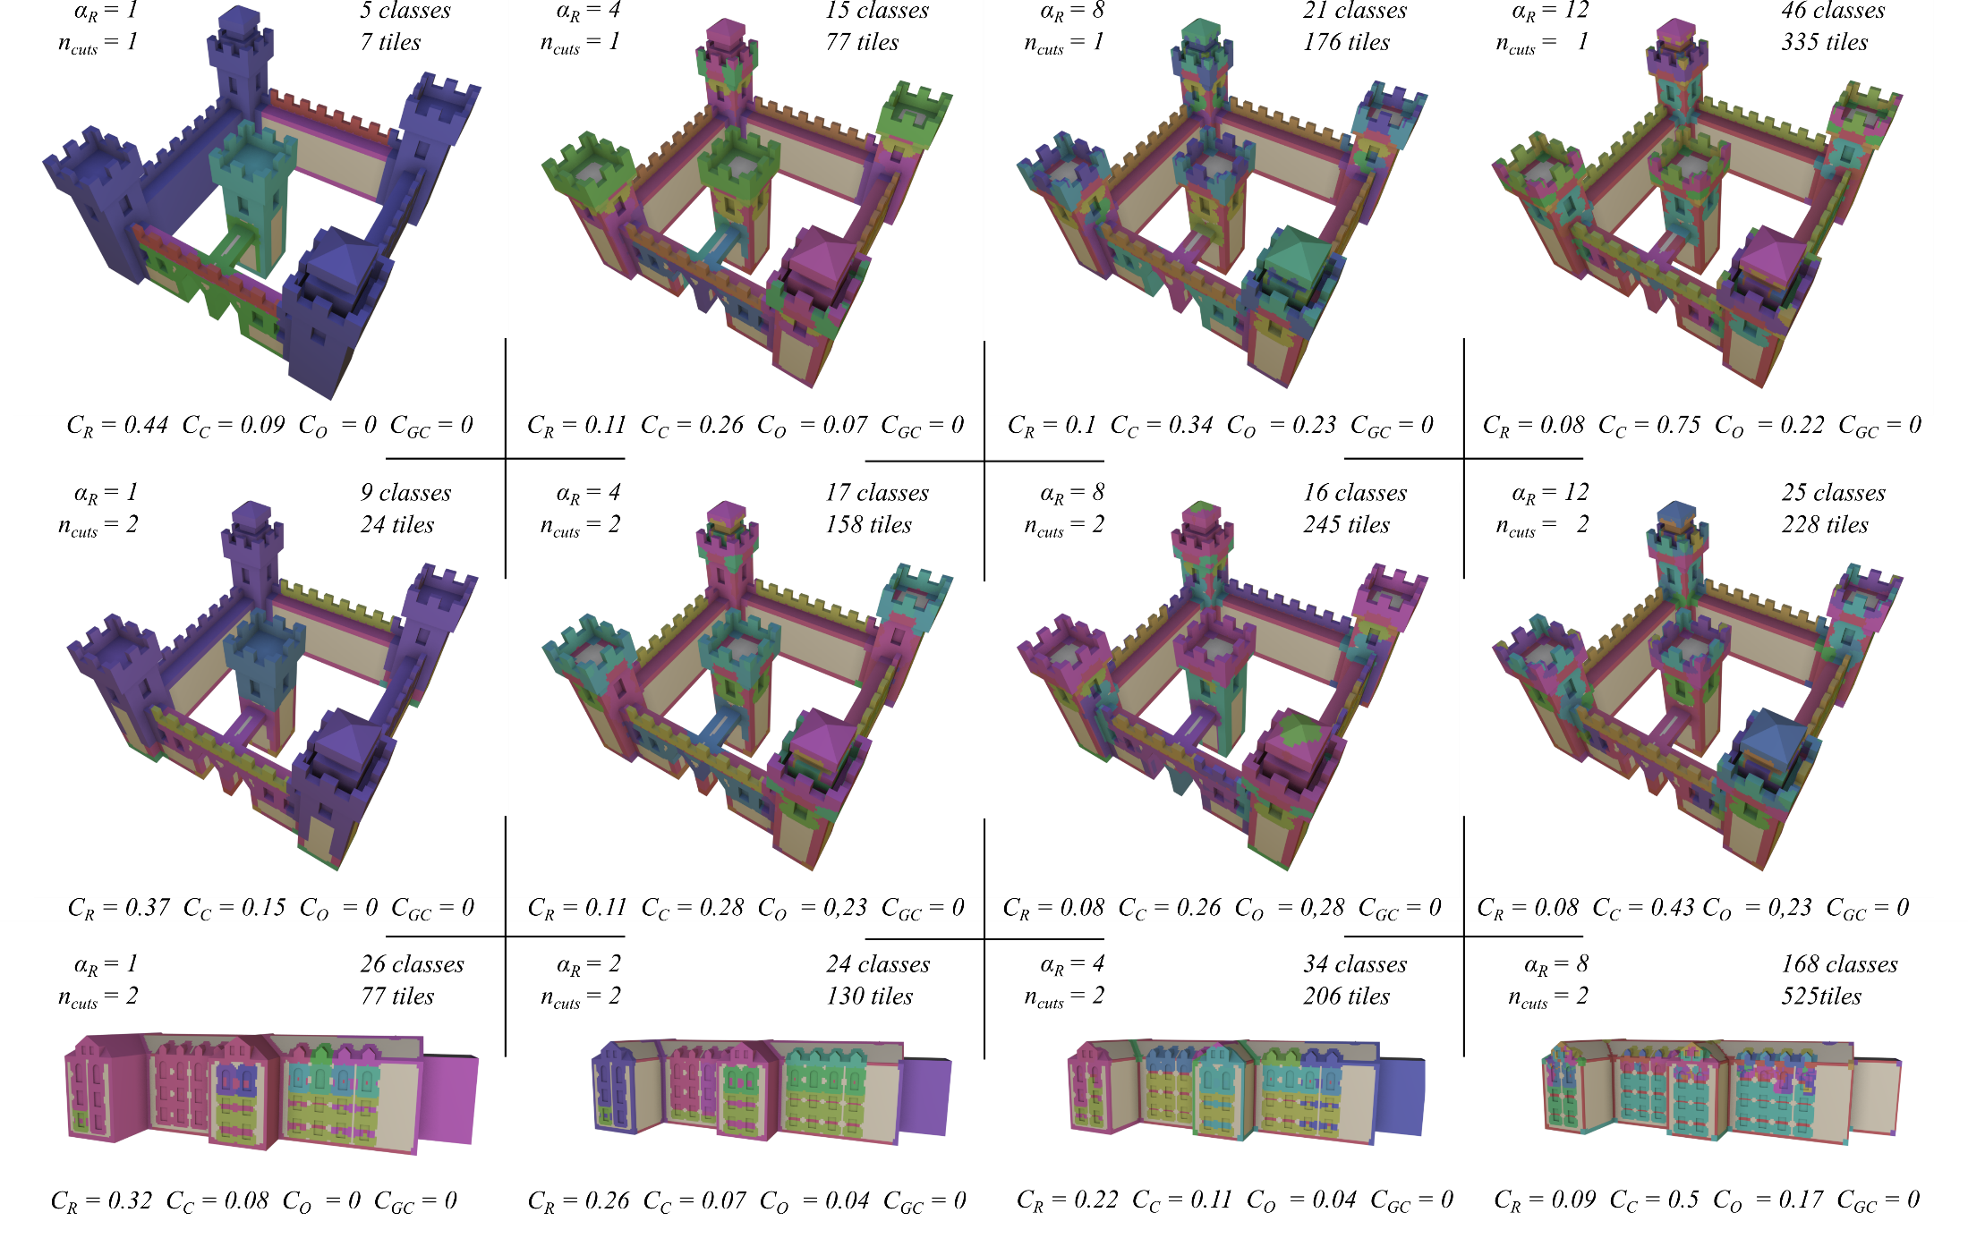
Simplification Parameters

Slide 27
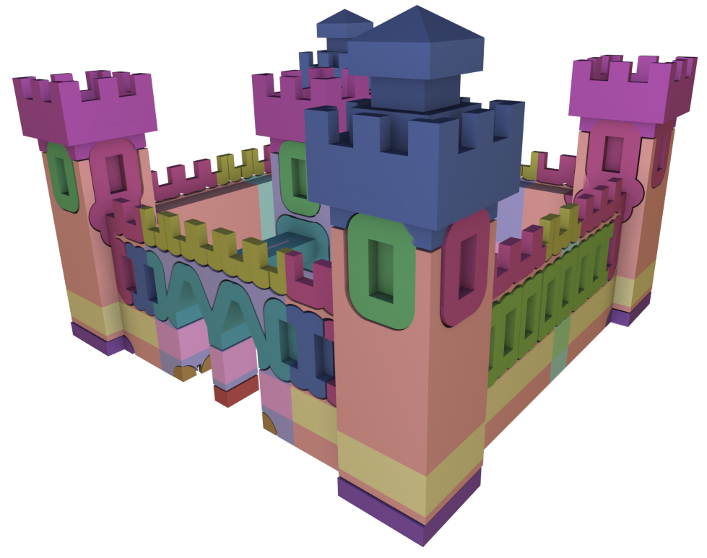
Conclusion
Inverse modeling of constructor sets
  Simplification of tiling grammars
  Exact symmetry detection

Slide 28
Thank You
Thanks
Silke Jansen
Dan A. Calian
Han Liu
Jordan Bowden
Stu Boyd
Tony Cervantes

