Slide 1
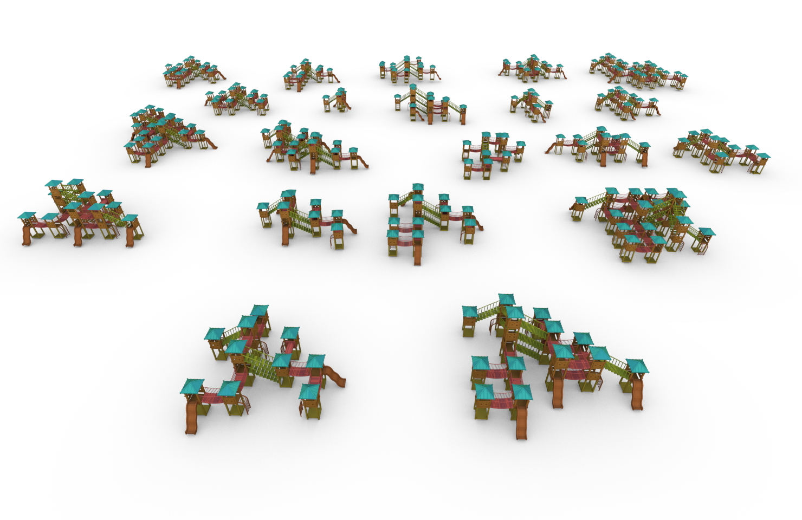
String-Based Synthesis of Structured Shapes
Javor Kalojanov Isaak Lim Niloy Mitra Leif Kobbelt
Notes:
Hello everyone, my name is Javor and I will be presenting work done at the Visual Computing Institute at RWTH Aachen. Before I begin, note that we provide the full implementation of the paper as open source. I will therefore omit the non-interesting technical details.

Slide 2
Making 3D Modeling Available to Everyone
…by automating shape synthesis
Example workflow:
download existing shape
modify automatically
use the generated variant
Notes:
The problem we aspire to solve is automatic shape synthesis. We imagine a scenario in which a user without modelling skills would like to use an algorithm that modifies a 3D model downloaded from an online shape repository.
While the general problem is too difficult to solve with a single paper, we believe to have made a step forward and to have found some valuable insights.

Slide 3
Autoencoding Structured Shapes
training samples
constraints
synthesized variant
objectives
Continuous latent space
Encode/decode shapes as latent vectors
High level operations (e.g. shape interpolation)
Notes:
The direction we decided to explore is a machine learning method for synthesis of structured shapes.
We train a variational autoencoder, which learns a mapping between a set of shapes assembled from building blocks and a continuous latent space.
This reduces the process of shape synthesis to sampling points in the latent space and allows high level shape synthesis operations such as linear or other types of interpolation.

Slide 4
Related Work
Deep learning
Procedural modeling
[Li et al.]
[Sung et al.]
[Talton et al.]
[Ritchie et al.]
Notes:
The general idea of applying machine learning techniques for shape synthesis is not new. The most closely related techniques fall into two categories.
On the one hand, there are numerous recent applications of deep learning to shape synthesis. The examples here can create style variations of shapes you can find in a few existing shape databases.
Procedural modeling methods, on the other hand, either assume or infer an underlying model for creating shapes. The advantage these methods have, is that they require just a few examples to learn to produce plausible variants.
While not necessarily better in every aspect, our method improves upon the current state-of-the-art in the size and structural complexity of the output shapes. One very important limitation we do not have is the dependence on a hierarchical, or context-free description of the shapes.

Slide 5
Context-Free vs Tiling Grammars
context-free grammar
tiling grammar
Notes:
Using tiling shape grammars instead of the widely adopted context-free has several important consequences. First, it lifts the restriction on the shape graph topology and we can generate cycles, and regular patterns without requiring human intervention. Since the grammar rules are simpler, computing them for input shapes without semantic information becomes easier.
On the other hand, the problem of creating shapes (or words) in a non-context-free language is undecidable or NP-hard at best. This makes generating shape variations much harder. Our algorithms work with context-free shape families too, but we only focus on the harder problem in this talk and in the paper.

Slide 6
Tiling Shape Grammars
neighbour types
neighbour counts
4
2
A D
A
B
1,2
2
C D
C
D
input shape
B D
extracted grammar rules
variant
invalid variant
Notes:
Instead, we extract a tiling shape grammar. This is a set of rules describing locally what are the allowed ways to attach building blocks to each other. In the simplest form, our grammar rules consist of the types of pieces that can be put together and the number of neighbours each piece allows.
In this example the green tower can attach to one or two pieces, because only these configurations have been observed in the input shape. Simple as they are, these rules allow to discard the shape on the bottom right as invalid, because it contains a pair of overlapping (or connected) green towers, which violates the first set of rules.
Using the more general tiling shape grammars instead of context-free grammars make sense in an inverse procedural modeling scenario, however has the disadvantage that the problem of creating shapes (or words) in a non-context-free language is undecidable or NP-hard at best. This makes generating shape variations much harder. Our algorithms work with context-free shape families too, but we only focus on the harder problem in this talk and in the paper.

Slide 7
Shape Representation via Strings
B
A
D
C
D
CDA0(DC)DCDBDCDCD0
A0(DC)(DC)DCDBDCDCD0
A0(DC)(DCDBDCDCD0)DC
B(DCDCDA0CD)DCDCDC0
B(DCDCDC0)DCDCDA0CD
C
D
D
0
D
C
D
C
D
C
input shape
shape graph
strings
variant
invalid variant
Notes:
The core insight of our paper is the idea of representing shapes and their structure via strings and use these strings for machine learning as if they are words or sentences of a language. In other words, the connection between formal languages and procedural modelling allows us to represent shapes as text, and use methods for natural language processing for shape synthesis.
We achieve this in two steps, starting from a shape with a known decomposition into parts, going trough a shape graph and mapping the graph topology to a string. The strings can be mapped back to shapes that have matching graph topology. Note that both mappings graph to string and string to shape are not unique.
The first step of the process: computing a shape graph (or a contact graph) is not very interesting. We implemented this using collision or proximity detection, and if you are particularly lucky, this information can be read out from a scene graph provided with the input shape.

Slide 8
Notes:
The second part: going from a graph topology to a sequence looks like this: we linearize the graph and convert it to a sequence of characters.

Slide 9
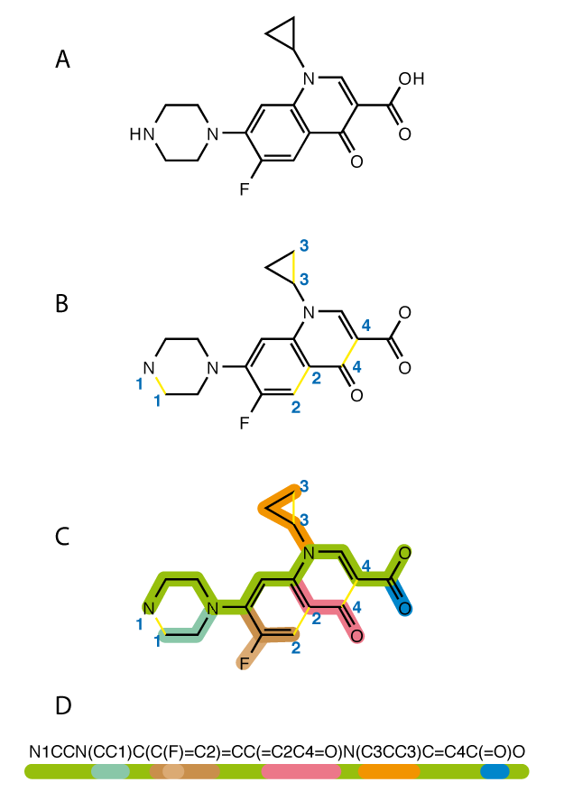
SMILES Strings
Simplified molecular-input line-entry system
text representation for molecule formulae
Graph-based definition
depth first search on a spanning tree
additional symbols to close cycles
Arbitrary graph topology
special characters for branching and cycles
[Wikipedia]
Notes:
More formally, the method we used is an adaptation of SMILES strings (a method for encoding molecule formulae as text):
First, we break all cycles of the graph by marking one edge per cycle. The remaining edges of the graph form a spanning tree. It can be linearized by ordering the nodes in the order they are visited by depth first search.
Branches at each node are enclosed by brackets, and the cycle edges are added back by numbering them and inserting their id next to both nodes connected via the edge.

Slide 10
Sequence Learning for Shapes
constraints
objectives
shape
graph
strings
variational autoencoder
D(CDADBDA(DC)(DC)(DC)DCDCDCDBDADCDC0)CD0
D(CDA…
CDA(DC)(DC)(DCDCDCDBDADCDC0)DBDADCDCD0
D(A(DC)(DC)(DC)DCDCDCDBDADCDC0)BDADCDCD0
D(A(D…
encoder
decoder
Notes:
The machinery so far allows us to solve the first part of our pipeline: by representing shapes as strings, we can convert shape collections into text databases. These can be used for various machine learning methods for natural language processing.
We implemented a recurrent variational autoencoder used to generate both sentences in English and molecule formulae. Its essential property for our application is the ability to map the input set of training samples to points in a continuous latent space. This latent space (or parts of it) can be decoded back to strings. We can therefore generate new variations by sampling in the autoencoder’s latent space and trying to decode the samples to strings.
Before I reveal how exactly the decoded strings are mapped back to shapes, I will make a small detour and fill in a gap of the pipeline not shown on the slide: namely, how do we generate large enough training sets, from a model we found online.

Slide 11
Procedural Training Data
Notes:
The short answer is a connection between partial symmetry and inverse procedural modelling first introduced by Martin Bokeloh et al. In our case, we consider the shape graphs of a pair of shapes and sample a random subgraph on one of them. Attaching the subgraph at a compatible location on the second shape graph can create a new variant.
The principle is very simple, but not easy to realize in practice without relying on user input. We nevertheless came up with a solution and used it to generate training data.

Slide 12
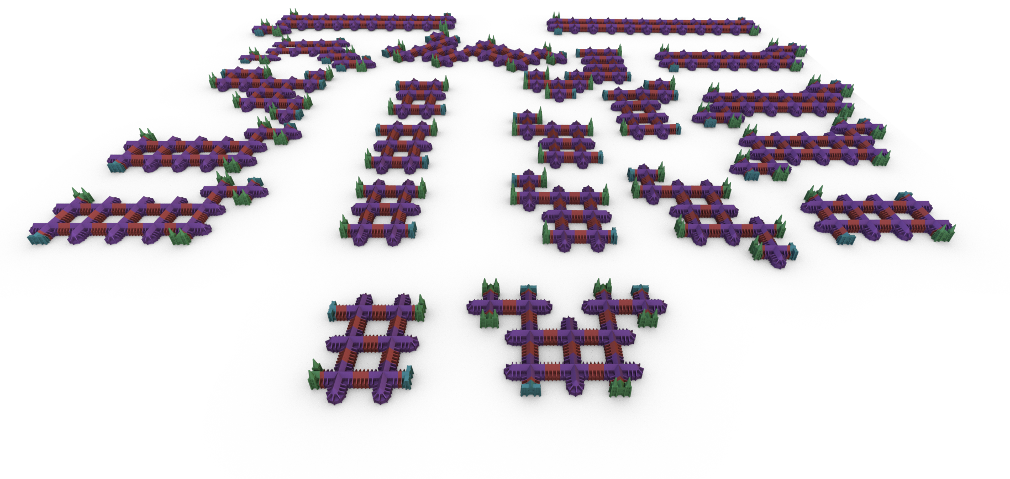
Notes:
Our test models are meshes that we downloaded from public collections like thingiverse. We segmented the model into parts and assembled 2 example structures shown in the foreground. The remaining shapes were generated fully automatically by iteratively applying the graph-based variation synthesis.

Slide 13
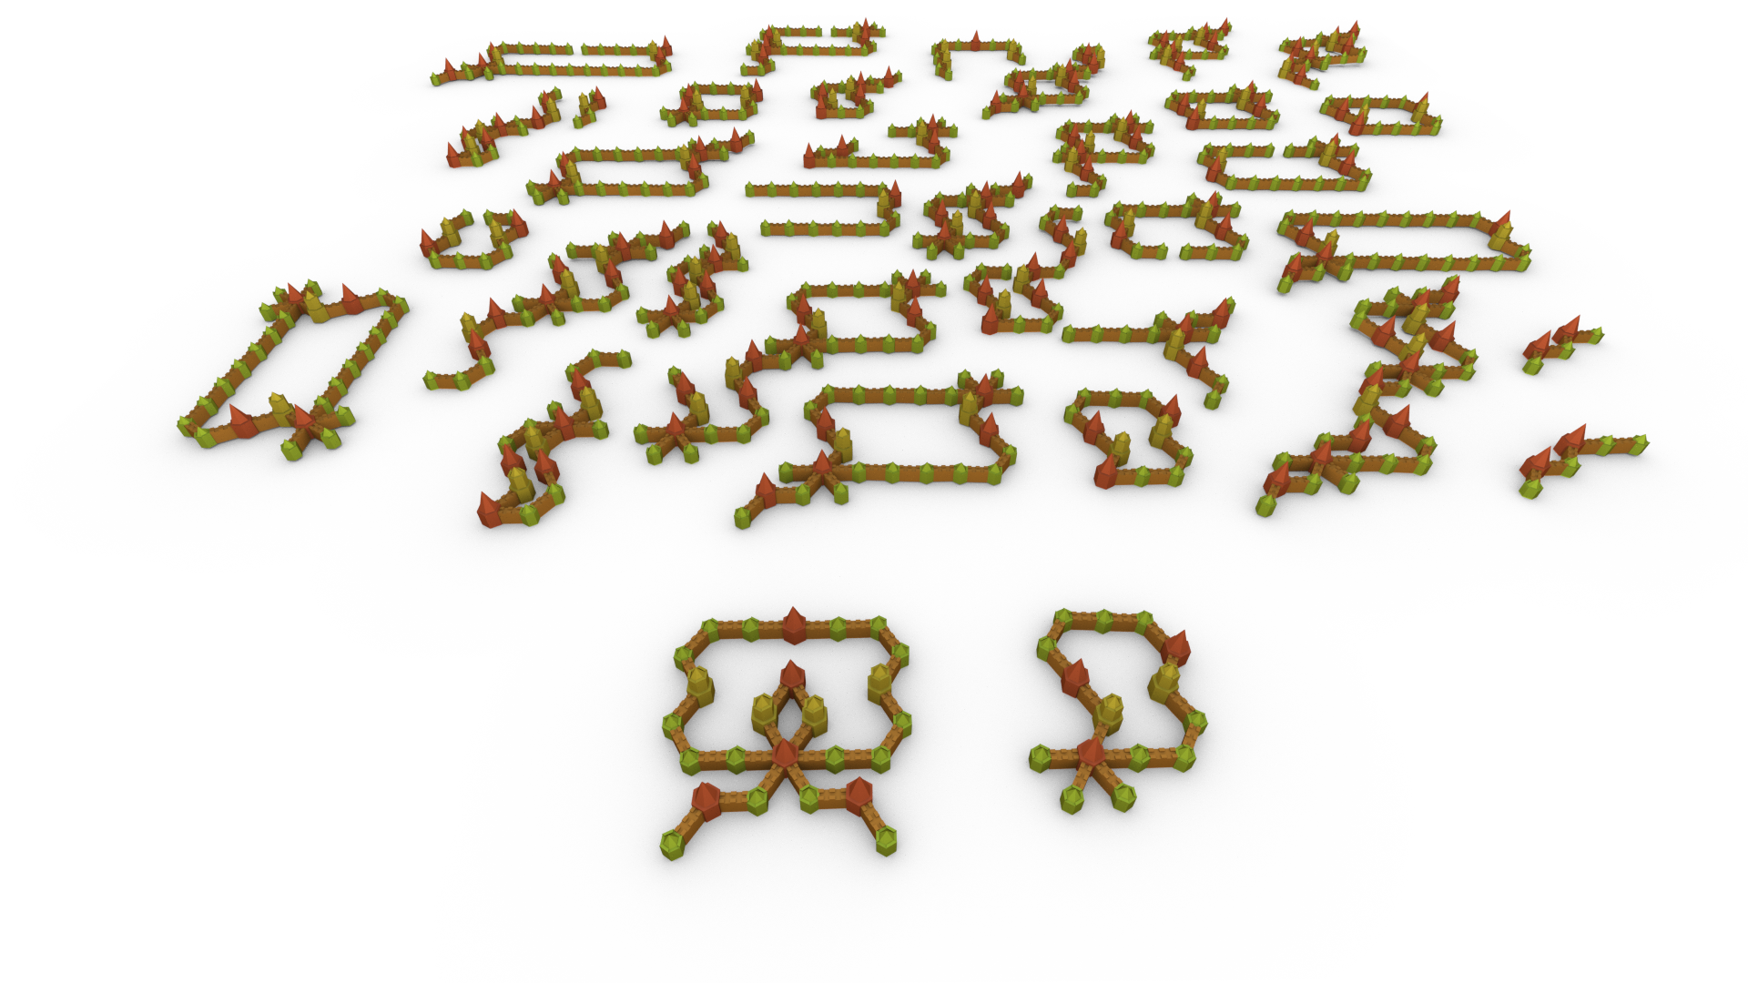
Notes:
Some models were already segmented into pieces, and we only needed to compose two interesting starting examples.

Slide 14
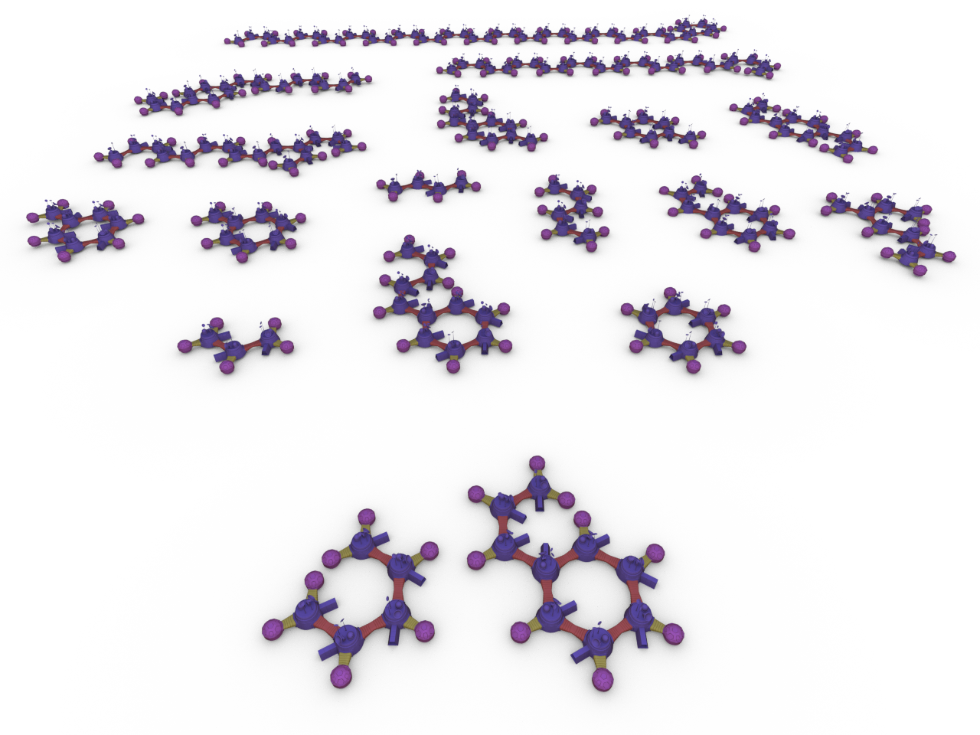
Notes:
The moon base has relatively simple structure and very high polygon count, which makes it mode difficult to generate enough examples for training.

Slide 15
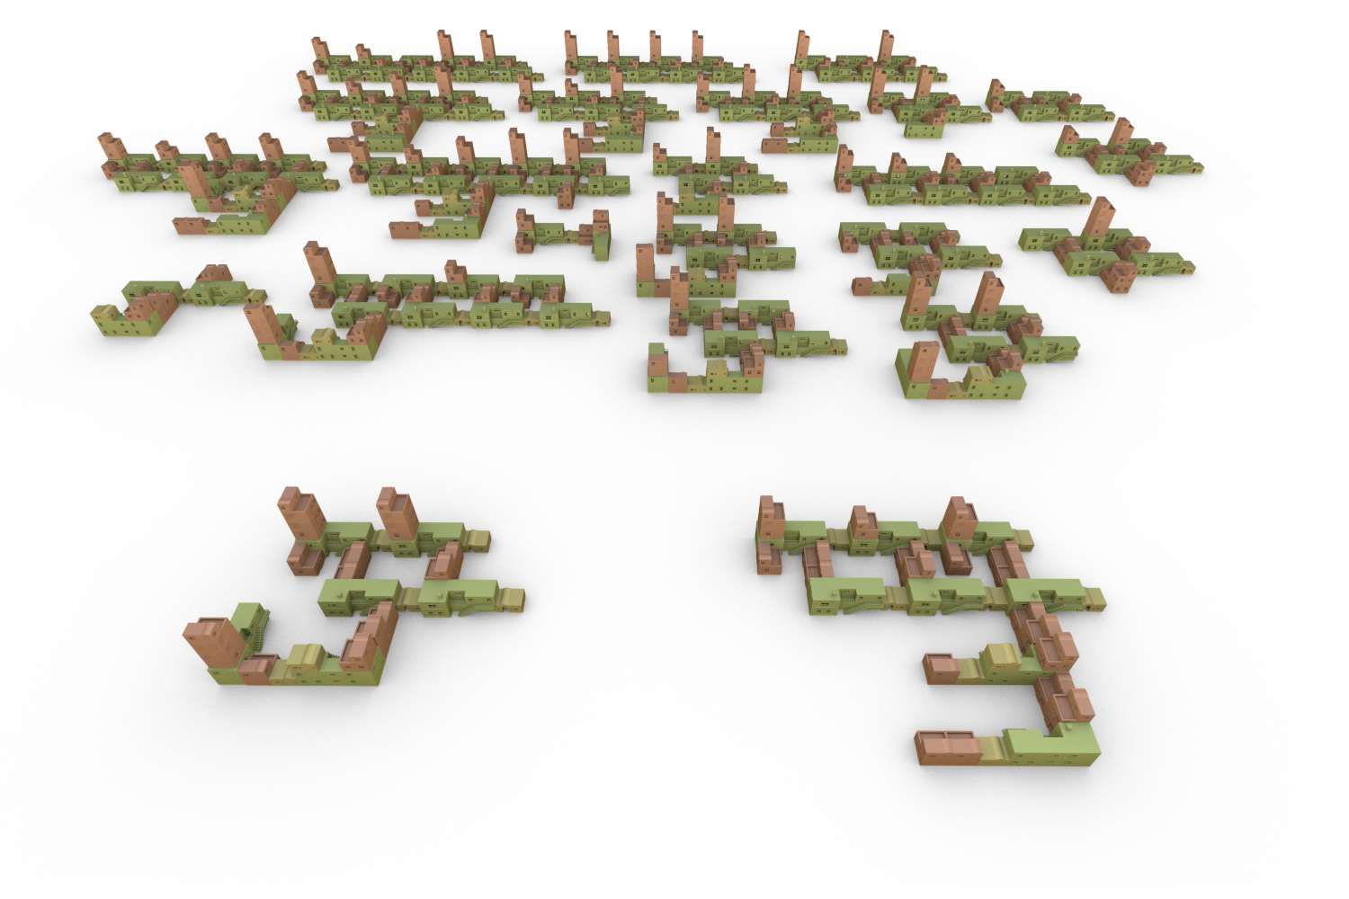
Notes:
This dataset on the other hand required just two iterations to generate more than 1000 example shapes and over 400000 strings.

Slide 16
Notes:
The playground dataset has been used in related works for inverse procedural modeling. The interesting feature here is that we marked pieces with different shape with the same type.

Slide 17
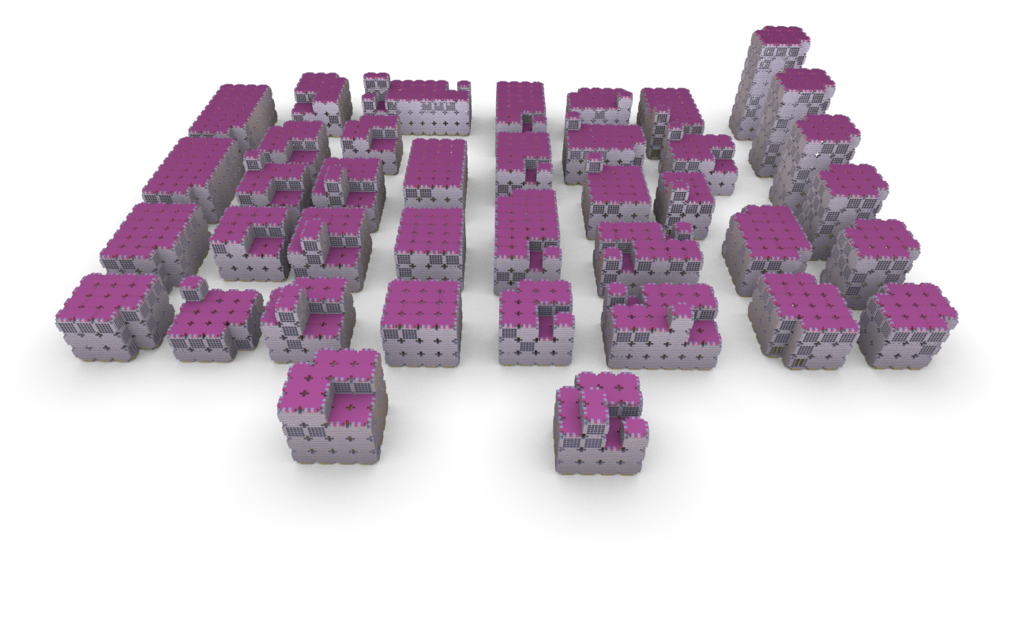
Notes:
This dataset turned out to be particularly difficult to use for training due to the large number of cycles each shape graph contains. The buildings are made out of square tiles, and each has 4 neighbors. Because we use special characters for encoding cycles and branching, and rely on the neural network to figure out by itself that these characters behave differently, we had to use significantly larger networks to be able to train.
While we have several ideas of how to address this in future work, the current implementation does not scale very well with high number of edges in the shape graphs.

Slide 18
Instantiation of Structure Graphs
constraints
objectives
Notes:
So far we explained how to generate a set of sample shapes for training, and convert them into strings in order to train a variational autoencoder. We can then use the autoencoder to generate new strings that represent shapes.
It remains to show how to convert the strings representing graph topologies back into 3D models.

Slide 19
Edge Category Estimation
6
4
A D
B D
6
2
C D
D A
2
2
D B
D C
input model(s)
edge types
relative positions clusters
edge categories
Notes:
Our approach for graph instantiation consists of two main parts.
Until now we only considered the topology of the graph. Therefore, we first augment the tiling grammar with edge categories: the relative spatial arrangement of neighbouring parts.
We compute the possible ways to attach pairs of pieces of certain types together by mean shift clustering their relative positions and orientations.
You can see how the clusters and the resulting configurations look like in the right. The numbers next to each example indicate how many ways can piece B be attached to piece A, and the figure shows the examples.

Slide 20
Edge Category Estimation (2)
relative positions clusters
AA
AB
2
2
AC
AD
2
2
DA
3
1
BA
CA
1
input model(s)
edge types
edge categories
Notes:
This is the same breakdown for a different model, where the position clusters were more spread out because the examples were intentionally put together imprecisely. We wanted to test how robust our method is to minor artist mistakes during placement of the pieces.

Slide 21
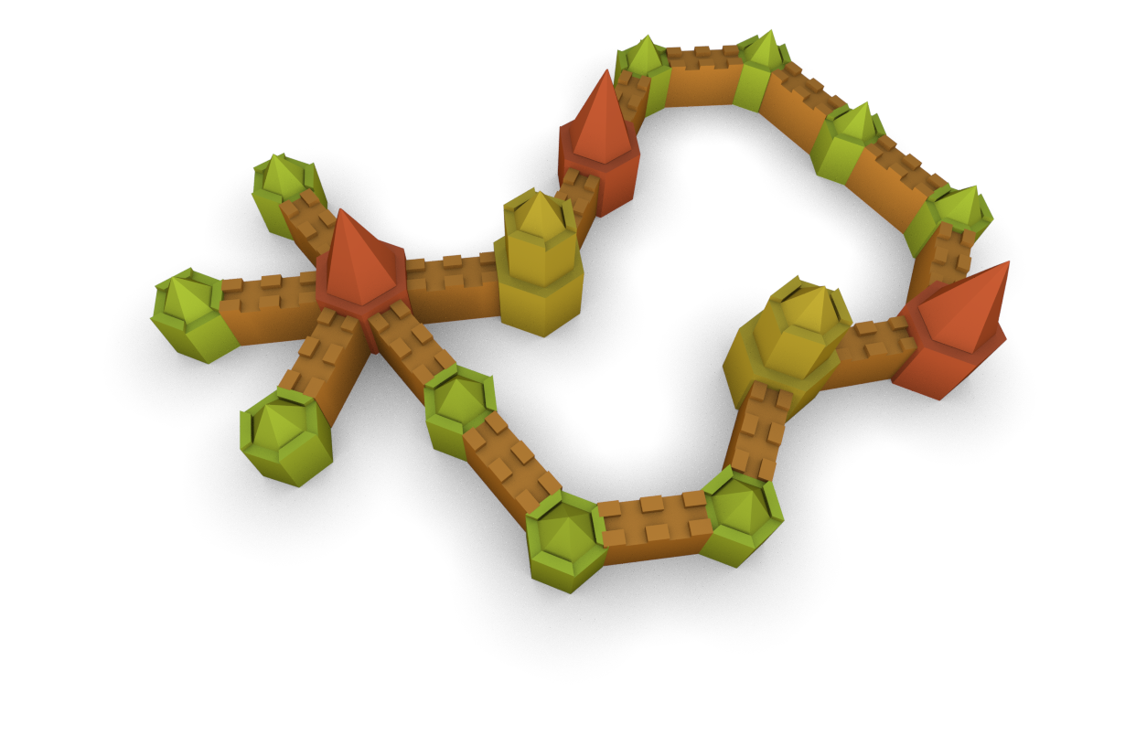
Edge Category Learning
Sequence-to-sequence encoding
similar to language translation
Learn a mapping from strings to sequences of edge configurations
B(DADCDCDCDADCDADC)DADCDA(DC)(DC)(DCDCDCDCDADBDA(DCDADC)(DC)(DC)DCDCDCD0)DBDADC0
[22, 22, 18, 1, 17, 10, 20, 12, 20, 10, 20, 0, 17, 12, 20, 0, 16, 10, 22, 18, 2, 17, 11, 20, 3, 22, 17, 12, 22, 22, 16, 10, 22, 22, 17, 11, 21, 11, 21, 11, 20, 14, 20, 0, 16, 6, 18, 2, 22, 17, 12, 20, 0, 16, 10, 22, 22, 17, 12, 22, 22, 16, 10, 22, 17, 11, 21, 11, 21, 11, 20, 22, 22, 16, 7, 18, 1, 17, 13, 21]
Notes:
Once we have all edge categories, we train another neural network to “translate” the strings representing graph topology into a list of edge categories, which describes how the pieces have to embedded in space for the model to be created.

Slide 22
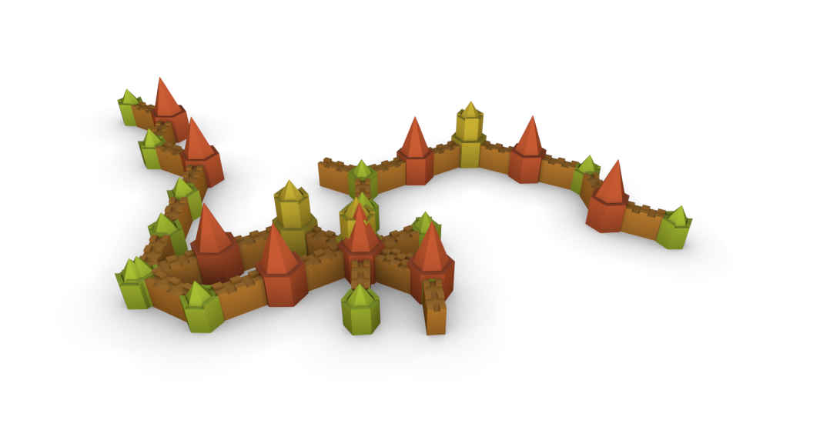
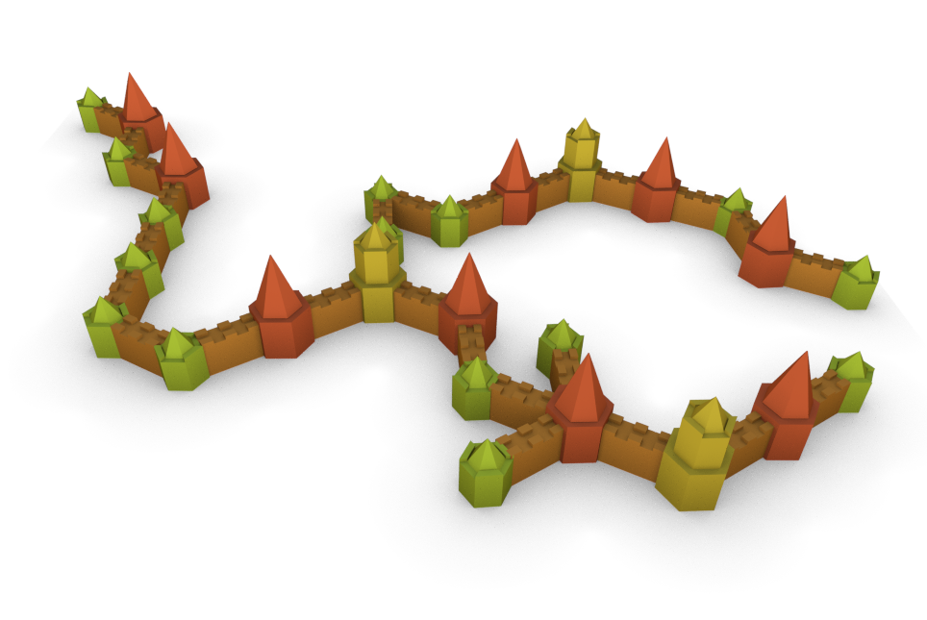
Graph Instancing
[29, 29, 13, 29, 0, 12, 29, 8, 29, 29, 0, 14, 29, 28, 29, 3, 29, 29, 29, 8, 29, 1, 12, 29, 27, 1, 29, 7, 29, 10, 29, 29, 8, 29, 1, 29, 29, 29, 7, 2, 16, 29, 7, 29, 29, 28, 29, 29, 28, 3, 29, 8, 29, 3, 29, 29, 3, 17, 29, 9, 29, 29, 7, 29, 28, 4, 29, 8, 29, 3, 18, 29, 7, 29, 29, 9, 29, 8, 29, 1, 11, 29, 0, 11, 29, 9, 29, 29, 8, 29, 7, 29, 29, 7, 29, 29, 1, 11, 29, 8, 29, 29, 10, 29, 0, 11, 29, 7, 29, 29, 9, 29, 8, 29, 8, 29, 29, 3, 15, 29, 1, 11, 29, 1, 11, 29, 0, 11, 29, 7, 29, 29, 9, 29, 8, 29, 29, 8, 29, 10, 29, 29, 0, 11, 29, 9, 29, 29, 8, 29, 7, 29, 29, 8, 29, 7, 29, 7, 29, 29, 9, 29, 29, 7, 29, 28, 0, 29, 8, 29, 3, 18, 29, 10, 29, 29, 8, 29, 7]
estimated embedding
valid embedding
Notes:
This part of our method can be improved upon, because the shape instantiation can become invalid even with one or two incorrectly predicted configurations like this example.
Our networks easily reached more than 90% prediction accuracy, but for the final embedding we still had to assemble the shape piece by piece, verifying at each step that the (partial) result does not violate the grammar rules.
This meant that sometimes we were not able to instantiate strings generated by the autoencoder. However, given the difficulty of the problem, we were satisfied to have discovered a data-driven method able to synthesize non-context free shapes with any success rate.

Slide 23
Shape Sampling and Interpolation
constraints
objectives
Notes:
Besides being able to generate random non-context-free shapes, our method provides interesting shape synthesis opportunities thanks to the latent space of the autoencoder.

Slide 24
Latent Path Sampling
A(B(AAAAB(AD)AAAAB(AAAA0)AC)AC)AAAB0AAAAB(AC)AAAAB(AD)AC
A(AAAB(AAAAB(AC)AA0)AD)B(AA1)AAAB(AAAAB(AAAB(AA0)AA1)AAAAB(AC)AAAAB(AD)AC)AC
A(AAAB(AAAAB(AC)AAAAB(AD)AC)AD)B(AC)AC
CAB(AAAAB(AC)AA0)AAAAB(AA1)AAAB(AAAAB(AAAB(AA0)AA1)AAAAB(AC)AAAAB(AD)AC)AC
B(AAAAB(AAAA0)AC)(AC)AAAAB(AAAAB0AAAD)AC
Notes:
Initially we tried various sampling techniques directly in latent space. I will skip point sampling and linear interpolation, and jump to what we called latent path sampling.
We select a pair of random points in latent space that represent the start and end shape, and find a path of shapes between them. You can think of this as the way the autoencoder would attempt to interpolate between the two end points.

Slide 25
Search Graph in Latent Space
Nodes:
points in latent space that decode to valid strings
Edges between:
points that represent the same shape
point and k-nearest neighbours in latent space
Edge weights:
similarity between node types histograms
Notes:
A more elaborate way to performing the same operation is to add a similarity metric in addition to the Euclidean distance in latent space to guide discovery of similar examples.
We implemented a search graph using Euclidean distance as a criteria for the graph’s topology and a simple similarity metric as an edge weight. This resulted in (subjectively) more intuitive interpolation results.

Slide 26
Paths with Similarity in Latent Space
Notes:
This time we perform shape interpolation by finding the shortest path on this precomputed latent/similarity graph.

Slide 27
Paths with Similarity in Latent Space
Notes:
The marked shapes were examples that we synthesized from strings discovered by sampling and were not present in the initial training set.

Slide 28
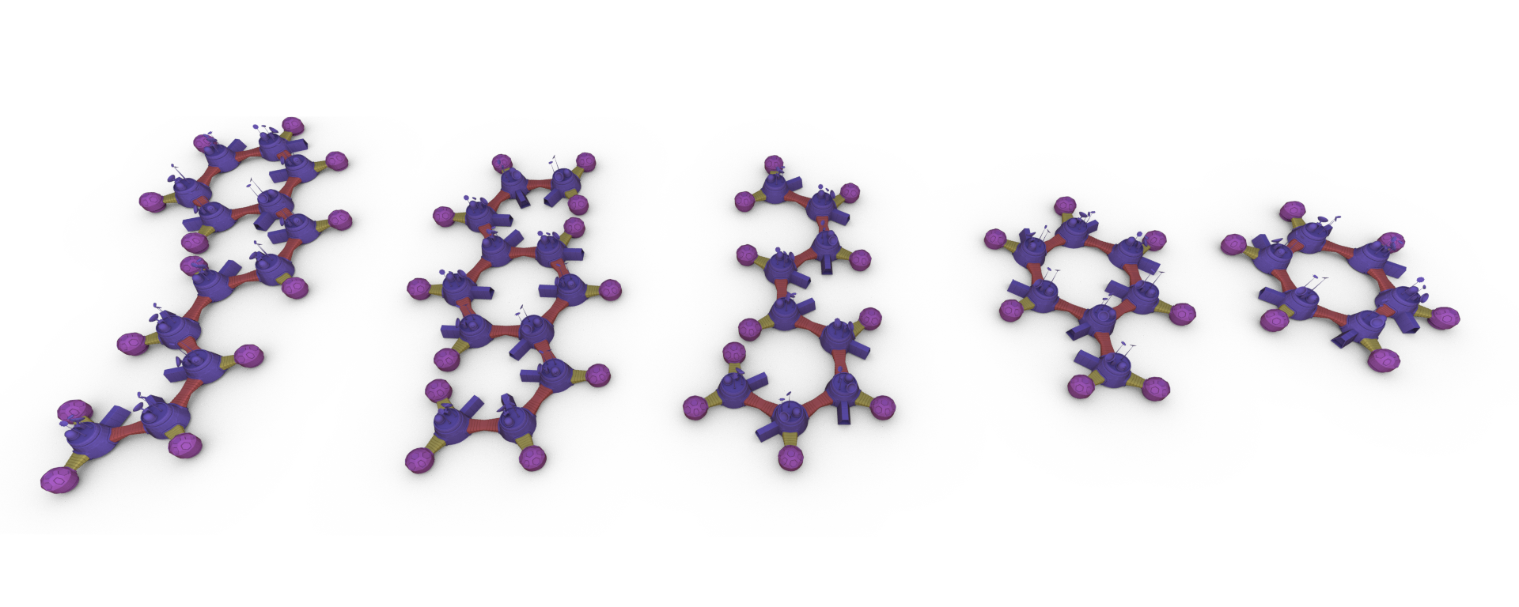
Paths with Similarity in Latent Space
Notes:
Note that the results depend to a large extent of the variability of shapes we generated for training. These dictate how “interesting” or “trivial” the intermediate results will be.

Slide 29
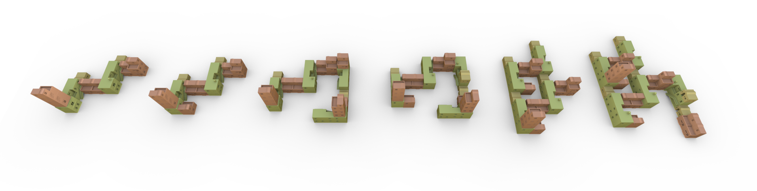
Paths with Similarity in Latent Space

Slide 30
Discussion
What did not work well
learning on shapes with many cycles
instancing graphs with long cycles
What worked well
synthesis of new strings from latent space
non-context-free graphs/shapes
mixing a similarity metric with distance in latent space
validation of sampled shapes
scalability with number of components, mesh size, “unclean” geometry

Slide 31
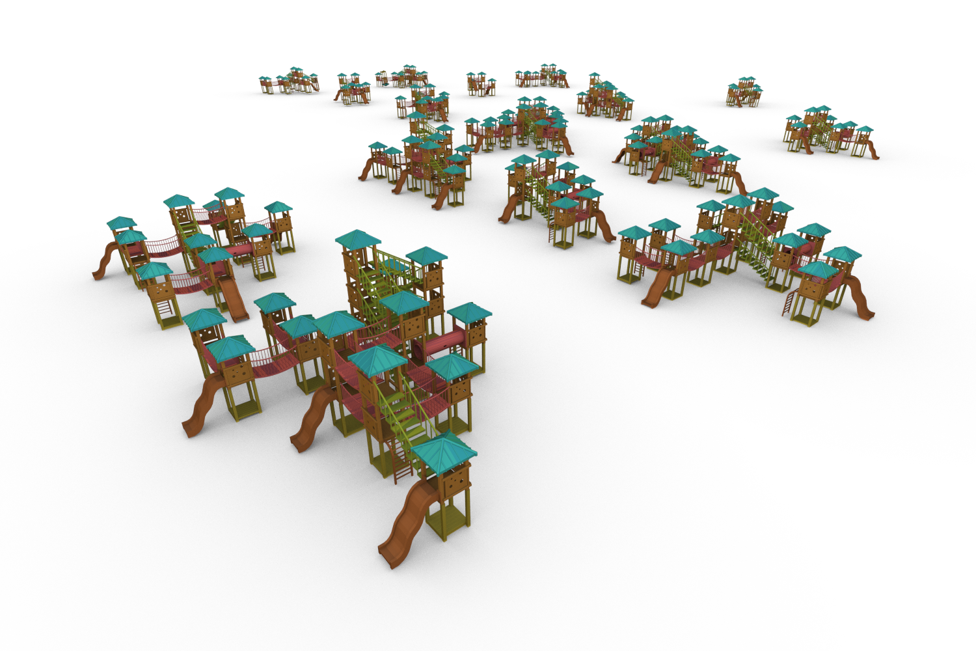
Conclusion
Data-driven synthesis of structural variations
large shape graphs
arbitrary* topology
shape interpolation
Procedural training sets
from 2 examples
Shape to string mapping
linearized shape graphs
output
input
Notes:
In conclusion, what sets our method apart from state of the art in the area are the results we are able to obtain.
We generate shapes with larger and more complex structure than previous methods. Particularly interesting is the ability to use a continuous shape representation of discrete shapes and the opportunities for shape synthesis it provides.
Another practical limitation we were able to lift is the dependence of a shape database with training samples. We procedurally generate training data from just two input models.
Finally, the most significant theoretical insight of our paper is the mapping of shape, or shape graphs to strings. This allows to transfer natural language processing methods for shape synthesis problems.

Slide 32
Thank You
https://github.com/javorkk/string2shape

