Slide 1
Two-Level Grids for Ray Tracing on GPUs
Javor Kalojanov, Markus Billeter, Philipp Slusallek
Notes:
Hello everyone, my name is Javor, and I will talk about grids, ray tracing and GPUs.

Slide 2
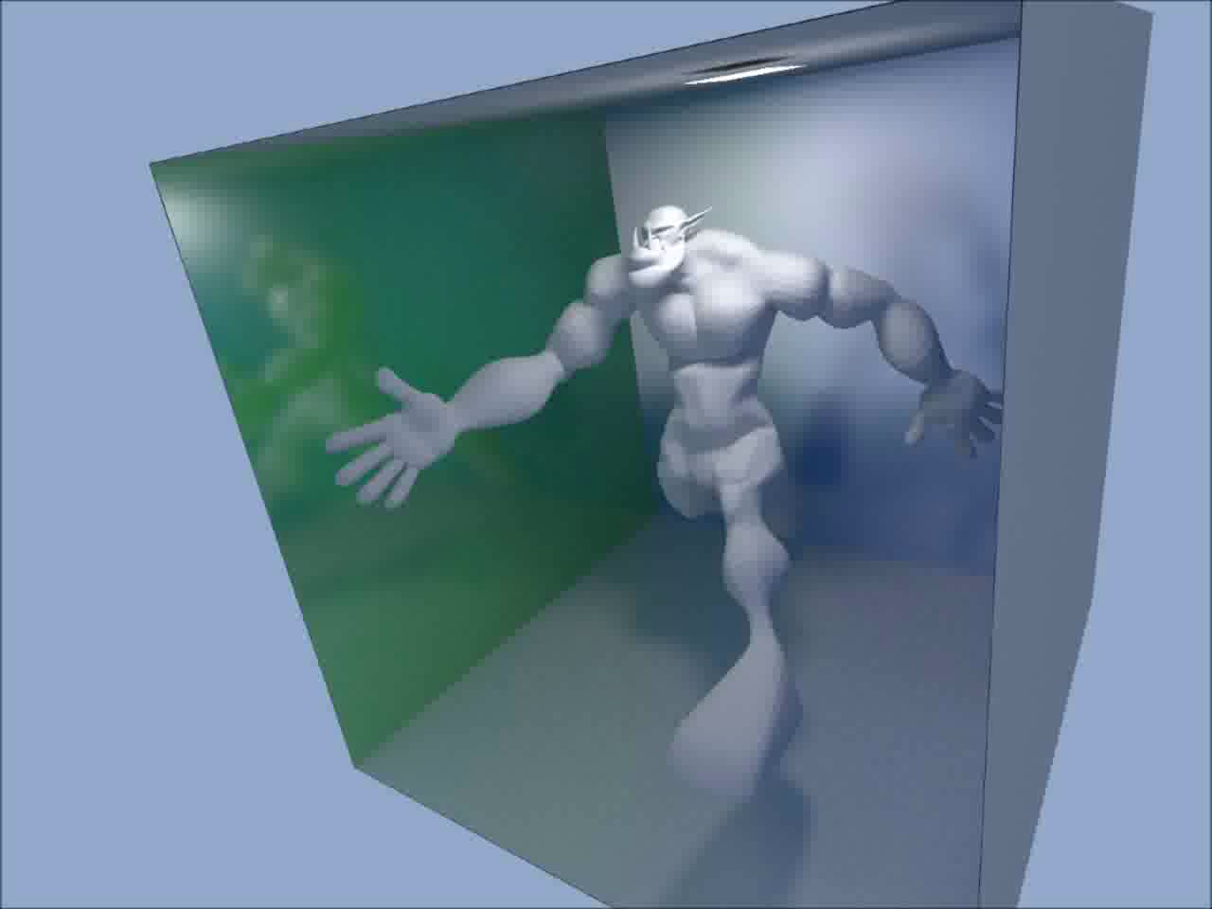
Motivation
  Real time ray tracing of dynamic scenes
Notes:
While ray tracing performance today is fast enough for interactive walkthroughs of static scenes, there are hardly any applications that handle dynamic scenes, not to mention dynamic scenes with arbitrary motion such as explosions for instance.

Slide 3
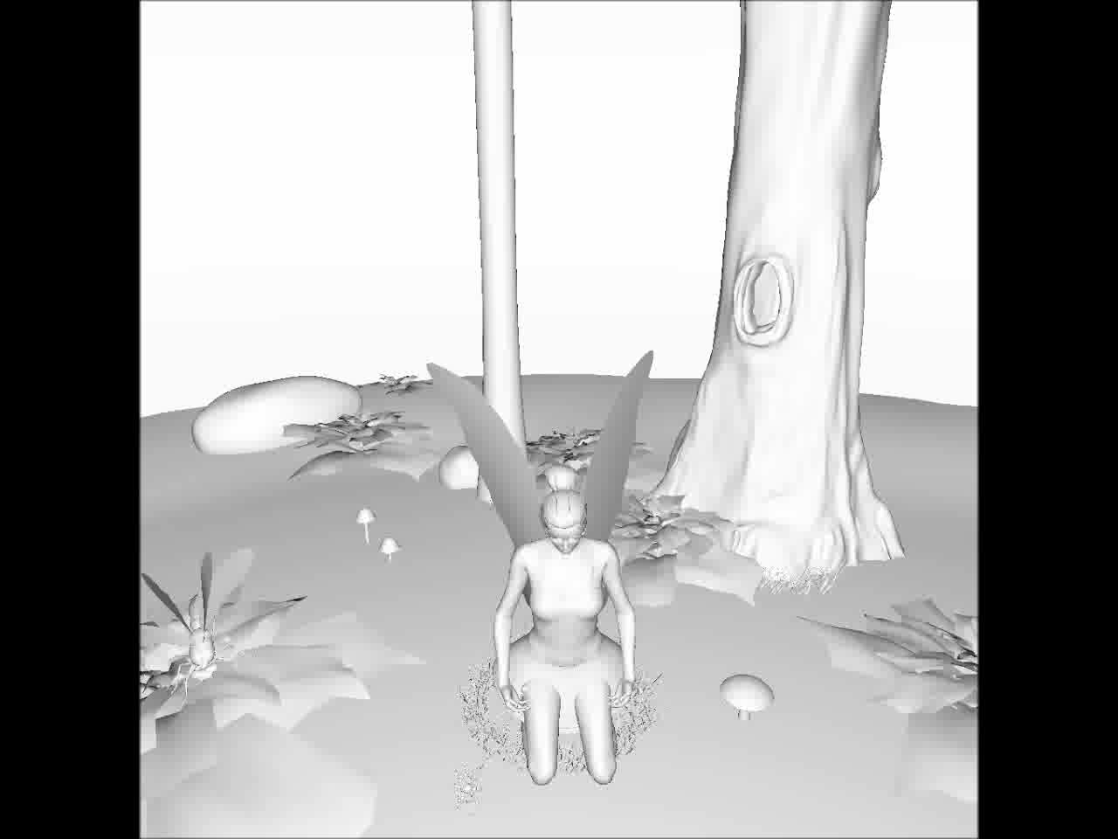
Notes:
While ray tracing performance today is fast enough for interactive walkthroughs of static scenes, there are hardly any applications that handle dynamic scenes, not to mention dynamic scenes with arbitrary motion such as explosions for instance.

Slide 4
Problems (Acceleration Structures)
  Time to image
    Build time
    Traversal performance
  High quality structures
    Slow construction
  Uniform Grids, LBVH
    Slow traversal
Notes:
Handling dynamic scenes for ray tracing is difficult, because high-performance ray tracers rely on high quality acceleration structures that are built offline.
Other acceleration structures like uniform grids or linear BVHs offer very fast build times and indeed good time to image, but compared to the structures used for static scenes, they offer poor acceleration and limit the amount of rays you can shoot in each frame.

Slide 5
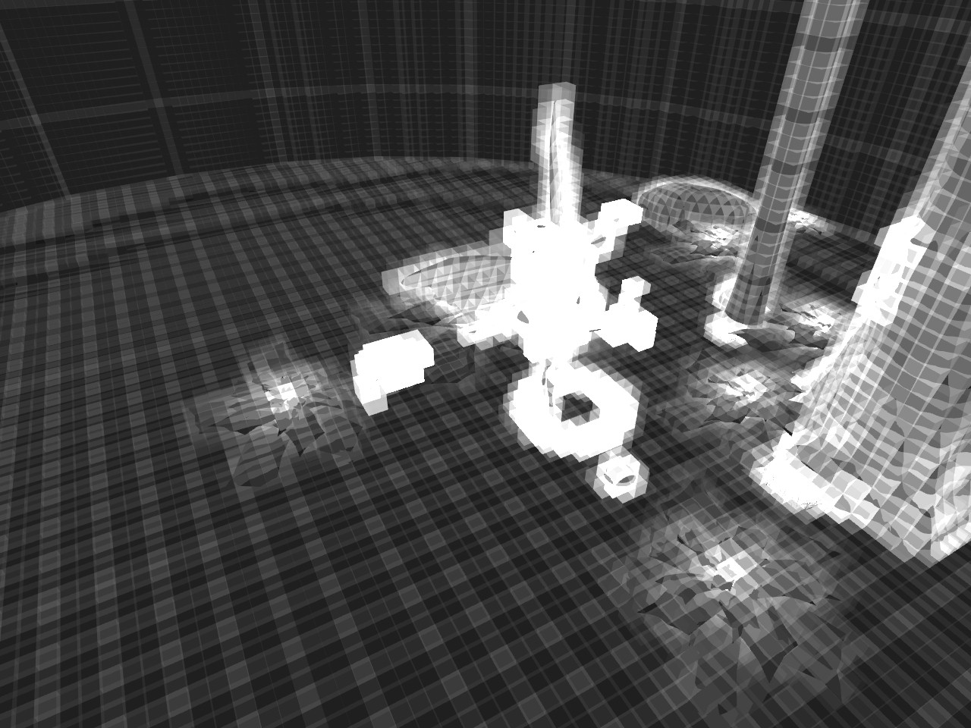
Notes:
The problem with uniform grids is that they cannot handle non-uniform primitive distributions in the scene – the so-called teapot in stadium problem.
This image visualizes the amount of intersection tests performed per ray for a test scene. It is obvious that there are large parts of the scene where the uniform grid fails to eliminate intersection candidates, which is the purpose of every acceleration structure.

Slide 6
Two-Level (Hierarchical) Grids
  Work around uniform grids shortcomings
D
C
A
B
Notes:
We wanted to work around this problems of the uniform grids, by making as little modifications to the uniform grid as possible.
A natural choice was to introduce another level of hierarchical subdivision. The two level grid is a uniform grid and each cell of this grid is a uniform grid of an arbitrary resolution.

Slide 7
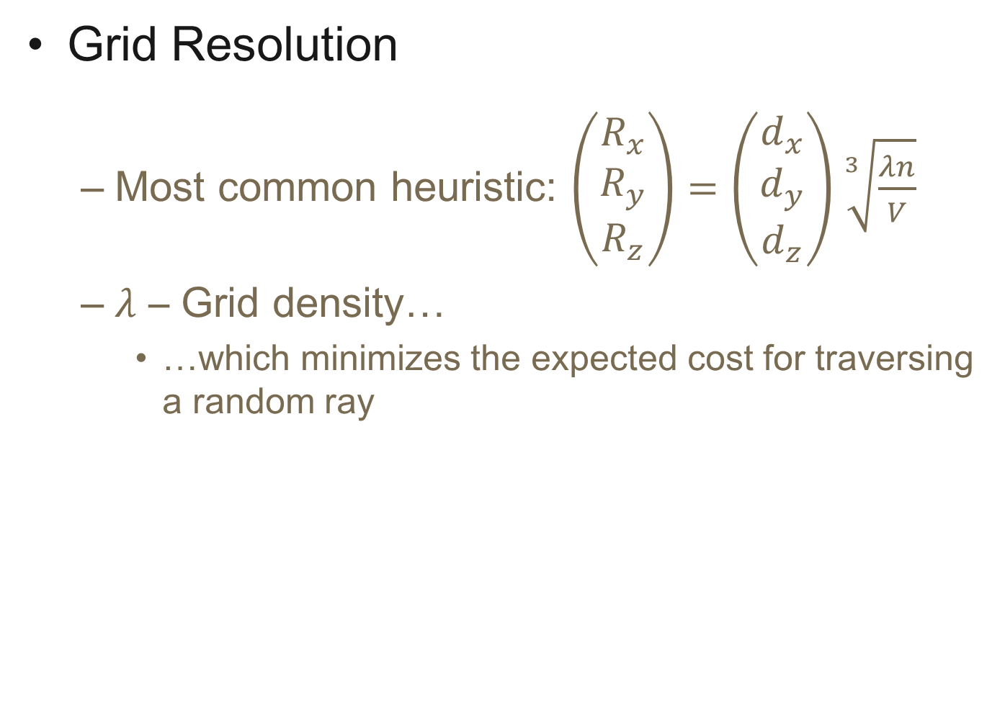
Grid Resolution
  Most common heuristic: $\left(\begin{matrix}R_{x} \\ R_{y} \\ R_{z}\end{matrix}\right)=\left(\begin{matrix}d_{x} \\ d_{y} \\ d_{z}\end{matrix}\right)\sqrt[3]{\frac{λn}{V}}$
  $λ$ – Grid density…
    …which minimizes the expected cost for traversing a random ray
Notes:
We base our choice of grid resolution on a heuristic commonly used for uniform grids. I will not go trough the formula, but the basic idea is to have grid cells as close to cubes as possible and select a number of cells that is linear in the number of primitives. This is where the only user defined constant called “grid density” comes from.
To “guess” the best grid density for our setup, we modified a small part of the construction algorithm and used it to compute a grid density that minimizes the expected cost for traversing a random ray trough the structure.
This strategy (and it’s variations) are considered the best choice for other acceleration structures like kd-trees and BHVs.
You can find more details on that in the paper.

Slide 8
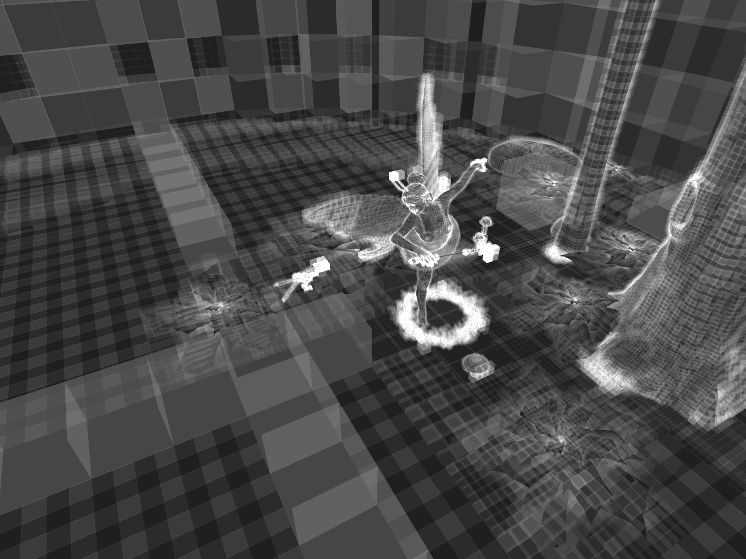
Teapot in Stadium
  Intersection tests
    Uniform Grid and Two-Level Grid
Notes:
Going back to the teapot in the stadium problem, we can see that a teapot in the stadium scene like the Fairy Forest does not present a problem and that the two-level grids are able to eliminate significantly more intersection candidates than the uniform grids.

Slide 9
Two-Level Grid Construction
Notes:
The rest of the talk is divided into two parts. We first describe a massively parallel construction algorithm for the two-level grids, thanks to whom we not only preserve the fast build times of uniform grids, but actually improve on them.

Slide 10
Data structure
Top Level Cells:
0, 3x3
9,1x1
10,2x2
D
0, 3x3
C
A
B
14,1x1
15,1x1
16,1x1
17,1x1
18,1x1
19,1x1
Leaf Array:
[0,0)
[0,0)
[0,1)
[0,0)
[1,2)
[2,5)
[0,0)
[0,0)
[5,7)
[0,0)
[0,0)
[0,1)
[0,0)
[1,2)
[2,5)
[0,0)
[0,0)
[5,7)
[7,8)
[0,0)
[0,1)
[0,0)
[1,2)
[2,5)
[0,0)
[2,5)
[0,0)
[0,0)
[5,7)
Reference Array:
0
1
2
3
4
5
6
7
8
9
10
11
2
3
4
C
B
12
C
C
D
B
C
C
A
A
B
B
C
C
B
A
Notes:
Before we take a look at the algorithms for construction, we need to understand the data structure and its representation in memory.
To use the grid as an acceleration structure for ray tracing we need to be able to tell which are the primitives inside a given cell in constant time.
The first level cells store the information needed to access the leaves inside it. This is the resolution of the cell and a location inside a leaf array where the first leaf that belongs to the cell is stored.
Each leaf stores data that describes which primitives does it contain. We keep all references to primitives inside a reference array and in the leaves we store the parts of this array with the corresponding references.

Slide 11
Sort-Based Construction
  Spatial index structure = partial ordering
  GPU friendly
    Works for LBVHs and uniform grids
  Idea
    Pair primitives with a key
    Sort by the key
    Extract the structure from the sorted data
Notes:
The data organization is important because it allows to reduce the grid construction to a sorting problem. This is to some extent intuitive, because spatial index structures actually store a partial ordering of the input objects.
And you want to do this, because if there is one thing GPUs are good at, that’s sorting! The approach is not new and known to work well for a type of BVHs and uniform grids.
The outline of a general sort-based algorithm for construction is the following: First we pair each of the input objects with a key, we then sort these pairs and read out the acceleration structure from the sorted pairs.

Slide 12
Top-Level Cells
D
(Cell ID, Prim ID)
A
C
Write Pairs
B
0
A
0
B
3
B
4
B
0
C
1
C
2
C
2
D
Radix Sort
0, 3x3
9,1x1
10,2x2
Extract Cells
Sorted Pairs
14,1x1
15,1x1
16,1x1
0
A
0
B
0
C
1
C
2
C
2
D
3
B
4
B
17,1x1
18,1x1
19,1x1
Notes:
Here is an example. To construct the top level of our structure, we use a sort-based method for uniform grid construction.
What we do is, we load the primitives in parallel and for each compute which cells does it intersect. For each primitive-cell intersection, or fragment, we write a pair of the cell index and the primitive index in a global array.
We then sort this array. As a result we get an array in which references to primitives inside each cell are stored continuously and we know where the data for each individual cell is to be found. From that we can either build a uniform grid, or in our case the top level cells of the two-level grid.
Note that at this point I am skipping quite a few details, that are to be found in the paper.

Slide 13
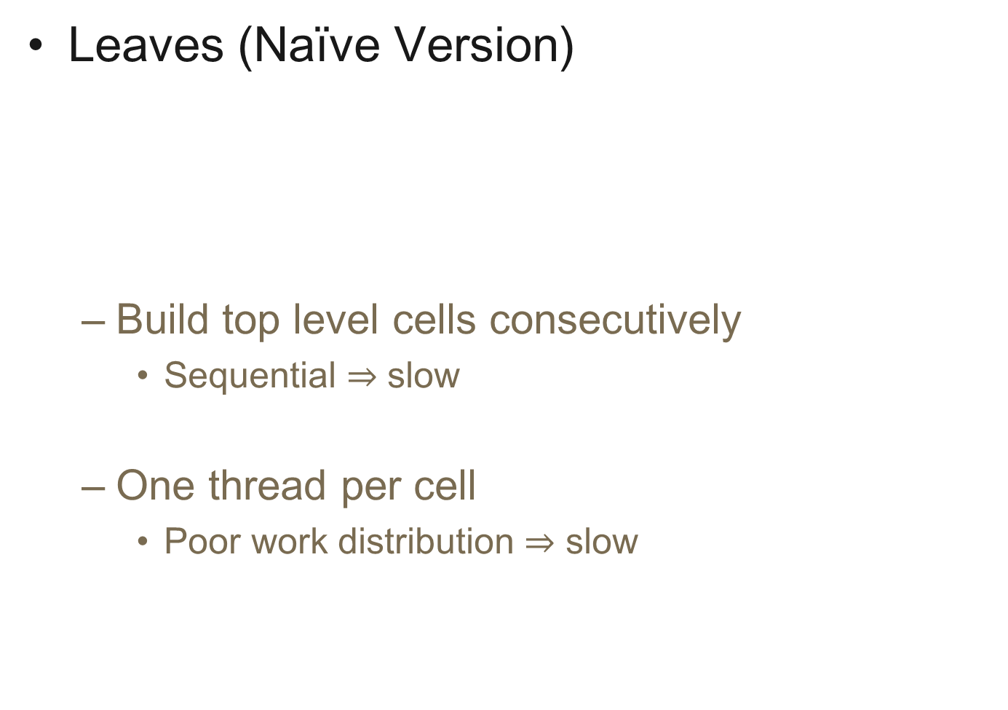
Leaves (Naïve Version)
  Build top level cells consecutively
    Sequential $⇒$ slow
  One thread per cell
    Poor work distribution $⇒$ slow
Top Cells
0, 3x3
9,1x1
10,2x2
14,1x1
15,1x1
16,1x1
0
A
0
B
0
C
1
C
2
C
2
D
3
B
4
B
17,1x1
18,1x1
19,1x1
Notes:
The next step of the construction algorithm is to build the leaf level cells.
There are several straight forward approaches to do that…

Slide 14
Leaves
Top Cells
0, 3x3
9,1x1
10,2x2
14,1x1
15,1x1
16,1x1
0
A
0
B
0
C
1
C
2
C
2
D
3
B
4
B
17,1x1
18,1x1
19,1x1
Write Pairs
(Leaf ID, Prim ID)
4
A
5
A
5
B
8
B
2
C
5
C
8
C
0
C
0
B
0
B
0
C
2
C
3
C
1
D
0
B
0
B
Same Leaf!
Notes:
The main contribution of our paper is an algorithm for construction of multiple uniform grids in parallel. The performance and work distribution is independent of the primitive distribution and the resolutions of the individual grids. This allows for perfect work distribution and no need for atomic operations during the build.
We write a pair of a key and primitive index in an array as we did previously.
This time however we can not use the leaf index as a key. If we would do that, we would have pairs with key 0 and both the dark blue triangle C and the green triangle B. This will put them in the same leaf, but they will be in leaf 0 of different top-level cells.

Slide 15
Which Key?
  Keys and leaf cells must be one-one correspondence
  Use the leaf positions in the array as keys
Leaf Array:
[0,0)
[0,0)
[0,1)
[0,0)
[1,2)
[2,5)
[0,0)
[0,0)
[5,7)
[7,8)
0
1
2
3
4
5
6
7
8
9
Notes:
The good thing is that we can solve this problem with a simple trick.
The issue we are facing is that leaf indices are not in a one-one correspondence with the leafs. In general, we need a unique key to identify each leaf cell.
If you recall, when describing the data layout of the structure, we mentioned that all leaves are stored in a 1D array.
We exploit this fact and take the position of the leaf inside this global array as a key.

Slide 16
Leaves (2)
  Single sort for all leaves
Top Cells
0, 3x3
9,1x1
10,2x2
14,1x1
15,1x1
16,1x1
0
A
0
B
0
C
1
C
2
C
2
D
3
B
4
B
17,1x1
18,1x1
19,1x1
Write Pairs
(Key, Prim ID)
4
A
5
A
5
B
8
B
2
C
5
C
8
C
9
C
12
C
13
C
11
D
14
B
15
B
Radix Sort
Sorted Pairs
2
C
4
A
5
A
5
B
5
C
8
B
8
C
9
C
11
D
12
C
13
C
14
B
15
B
Extract Leaves
[0,0)
[0,0)
[0,1)
[0,0)
[1,2)
[2,5)
[0,0)
[0,0)
[5,7)
[7,8)
[0,0)
[8,9)
Notes:
This, not only allows us to construct the complete array of primitive references in one pass, but also simplifies the generation of the array of leaf cells to a few lookups.
So the complete construction of the second level of the structure looks like that:
We write a pair of a unique key and primitive index in an array and sort just as we did previously. From the sorted data we can easily compute the leaf cells and the primitive array.
Note that we need a single sort for the entire second level and we parallelize over the pairs of level 1 in the first step, and the pairs of level 2 in the next steps.

Slide 17
Build Performance
  Very scalable
    100M pairs per second
  Small memory footprint
Notes:
The benefits from such construction strategy are the very high performance and scalability of the construction. The runtime only depends on the number or pairs we generate, and the spatial distribution of the scene primitives is irrelevant. Even if all primitives happen to be in the same leaf, the performance will not suffer.
In addition the memory footprint of the structure is very low, especially compared to uniform grids, because of the low optimal density for the two-level grid.

Slide 18
Build Performance (2)

Slide 19
Two-Level Grid Traversal
Notes:
To summarize. So far we found optimal parameters and build strategy for the two-level grids, which by construction resolve the teapot in the stadium problem.
In the next and last part of the talk we will address the ray traversal and describe how to make it SIMD-efficient.

Slide 20
Two-Level Grid Traversal on GPUs
  Uniform grid traversal
    For the first level
    For the second level
  Avoid code divergence
  Coherent memory access for coherent rays
    Must start in the same cell
Notes:
The ray traversal algorithm we used in our tests is a straight forward extension of a standard algorithm used for uniform grids.
We treated the top level and each of the top-level cells as individual uniform grids. To improve the coherency of execution, we force the SIMD units of the GPU to traverse on the same level of the structure. This eliminates code divergence and slightly improves performance.
The traversal algorithm favors coherent rays, because they usually require more local memory access.

Slide 21
Ray Coherence
  Memory coherence for rays starting in the same cell
1
Notes:
This is an example of what happens for uniform grids. Rays that start from the same cell, will always load a cell intersected by them at the same time.

Slide 22
Ray Coherence
  Memory coherence for rays starting in the same cell
2
2
Notes:
Even if they split at some point…

Slide 23
Ray Coherence
  Memory coherence for rays starting in the same cell
3
Notes:
They rejoin at the same step of the traversal if the go trough a given cell.
This is why tracing coherent rays is faster for uniform grids, and we exploit it by synchronizing the traversal of the top and bottom level of the two-level grids. This means that we finish tracing all rays in the second level, before we move to the next top-level cell.

Slide 24
Ray Incoherence
  SIMD inefficiency due to early termination
Thread Activity
Thread 1: active
Thread 2: active
Thread 3: active
Thread 4: active
Thread 5: idle
Thread 6: idle
Thread 7: idle
Thread 8: idle
Notes:
While the advancing through the cells is completely coherent in terms of executed instructions and almost so in terms of memory access, this is not true by default during the ray-triangle intersection stage of the traversal.
You can see that even for primary rays, it can happen that only part of the threads do some work during intersection. While others are idle, because they are responsible for tracing rays that are already terminated.

Slide 25
Secondary Rays
  SIMD inefficiency due to incoherence
Thread Activity
Thread 1: active
Thread 2: active
Thread 3: idle
Thread 4: idle
Thread 5: idle
Thread 6: idle
Thread 7: idle
Thread 8: idle
Notes:
The problem is of course bigger for incoherent rays, produced for example by a standard path tracer.

Slide 26
Work Distribution for Incoherent Workloads
  Standard packet ray tracer
rays
R1
R2
R3
R4
R5
R6
R7
R8
intersection candidates
Notes:
In this particular example only two of the rays have intersection candidates. A standard packet implementation will perform intersection tests horizontally, which will result in poor SIMD utilization. And 6 consecutive execution steps.

Slide 27
Work Distribution for Incoherent Workloads
  Vertical parallelization
rays
R1
R2
R3
R4
R5
R6
R7
R8
intersection candidates
Notes:
Note that this particular case can be computed more efficiently if we were to parallelize vertically instead of horizontally.

Slide 28
Hybrid Intersector
  Detect rays with high workload
    Compute intersections for single ray in parallel
  Proceed with the remaining rays
  Up to 25% overall speedup
    Brute force path tracing
    No other optimizations
  No overhead on Fermi GPUs
Notes:
Based on this observation, we tried a hybrid parallelization strategy in the ray triangle intersection stage.
We detected rays with high workload, and computed intersections for each of those vertically. Afterwards we proceeded with the standard packet intersector for the remaining tests.
We could achieve several times faster ray-triangle intersection in the best case, but because the method introduces some overheads for shuffling data the best overall speedup in rendering times was around 25%.
The good thing is that on Fermi GPUs we could exploit hardware support for functions like population count and prefix sum on warp level and eliminate the overhead.
While the overall speedup was not so big – got up to 10%, when we used other optimizations, we did observe performance boost even for primary rays on more complex scenes.

Slide 29
Results
Notes:
Finally I would like to briefly discuss some of our results, you can find in the paper.

Slide 30
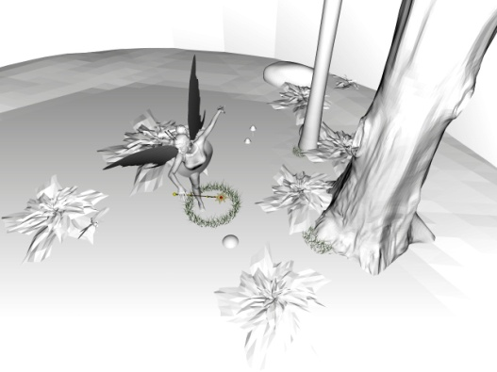
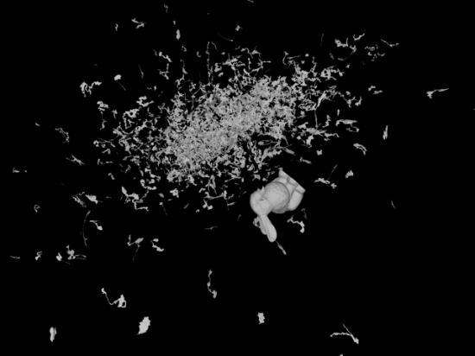
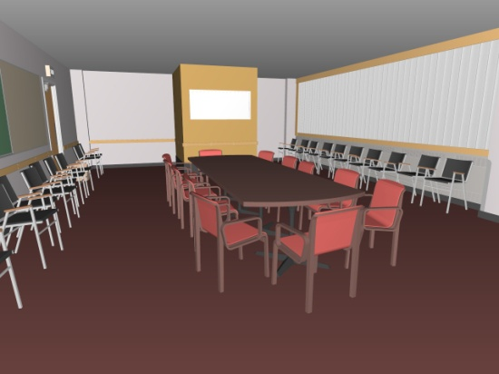
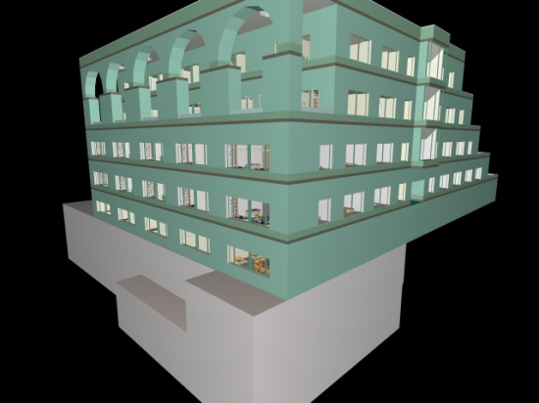
Results
Model (Triangles) | LBVH | Grid | 2lvl Grid | Hybrid BVH
Fairy (174K) | 10.3 ms 1.8 fps | 24 ms 3.5 fps | 8 ms 9.2 fps | 124 ms 11.6 fps
Bunny/Dragon (252K) | 17 ms 7.3 fps | 13 ms 7.7 fps | 13 ms 10.3 fps | 66 ms 7.6 fps
Conference (284K) | 19 ms 6.7 fps | 27 ms 7.0 fps | 17 ms 12 fps | 105 ms 22.9 fps
Soda Hall (2.2M) | 66 ms 3.0 fps | 130 ms 6.3 fps | 67 ms 12.6 fps | 445 ms 20.7 fps
Times for primary rays and simple shading (no shadows). Frame rate does not include build time. GeForce 280 GTX

Slide 31
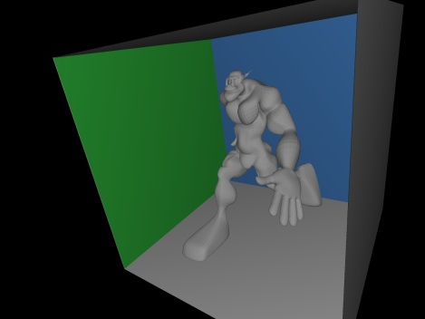
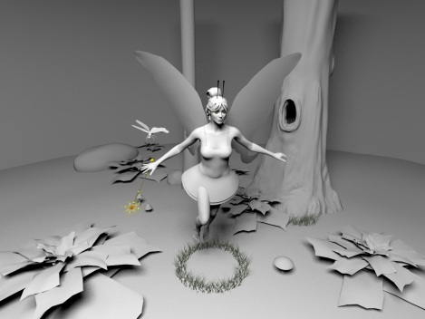
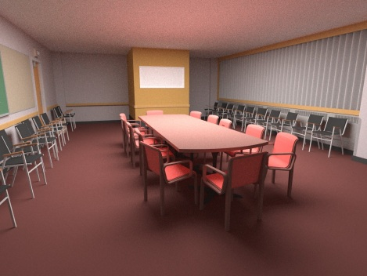
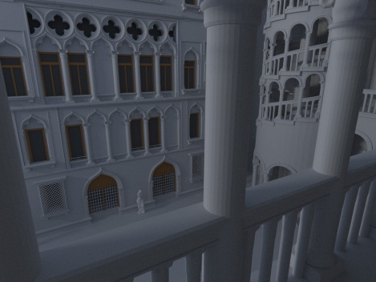
Results (2)
Model (Triangles) | Simple Shading FPS (MRays/s) | Direct Illumination FPS (MRays/s) | Path Tracing FPS (MRays/s)
Ogre (50K) | 31 fps ( 31 ) | 7.8 fps ( 39 ) | 3.4 fps ( 10.2 )
Fairy (174K) | 15 fps ( 15 ) | 2.7 fps ( 13.5 ) | 2.1 fps ( 6.3 )
Conference (284K) | 22 fps ( 22 ) | 3.0 fps ( 15 ) | 1.6 fps ( 4.8 )
Venice (1.2M) | 18 fps ( 18 ) | 3.3 fps ( 16.5 ) | 1.4 fps ( 4.2 )
GeForce 280 GTX

Slide 32
Conclusion
  Fast(est) rebuild from scratch
    Data parallel and scalable
  Fast time to image
    Even for “Teapot in Stadium” – scenes
    (Almost) no code divergence during traversal
Notes:
We showed how to construct the two-level grids very fast enough, to allow rebuild the entire structure every frame, and render animated scenes with arbitrary motion.
Mostly because of the build time, but also because of the good ray traversal performance we are able to achieve fast render times, even for scenes with complex primitive distributions, that are known to be hard for grids.
Last but not least we will take a look at how to improve rendering performance for incoherent rays, used for example when path tracing.
In addition the algorithms and ideas we presented are not restricted to grids. The main concept of the construction algorithm can be used for construction of other hierarchies, and the hybrid ray-triangle intersection algorithm makes sense for every sparse acceleration structure.

Slide 33
Acknowledgements
  Anonymous Reviewers
  Vincent Pegoraro

Slide 34
Thank You!

